Slide 1
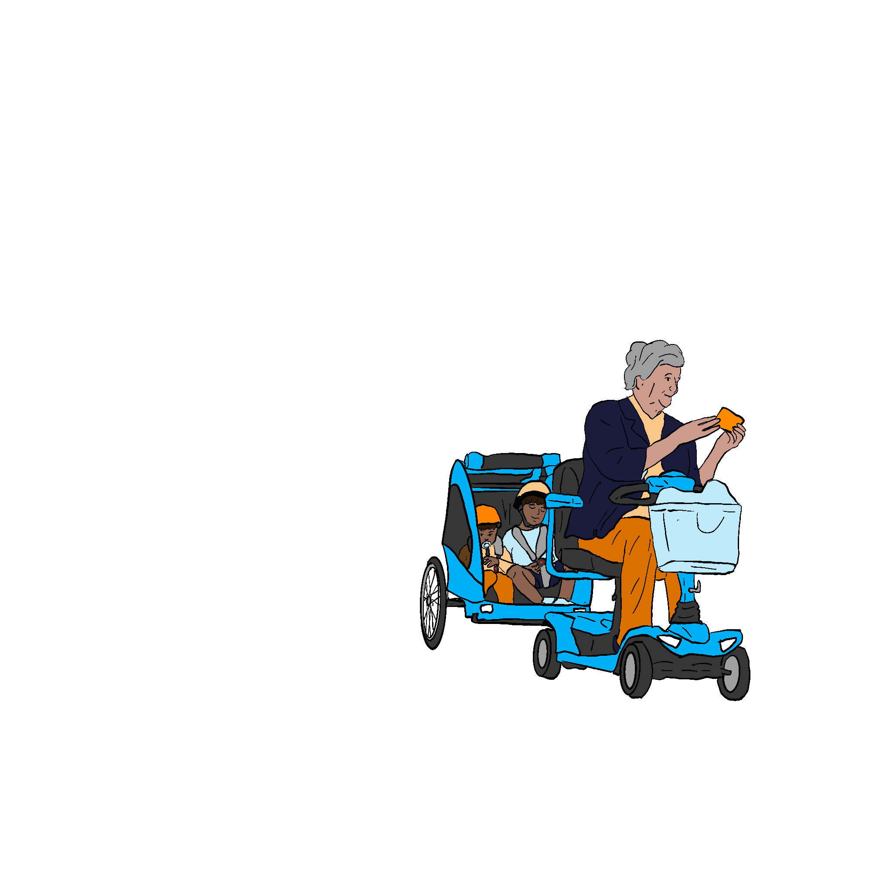
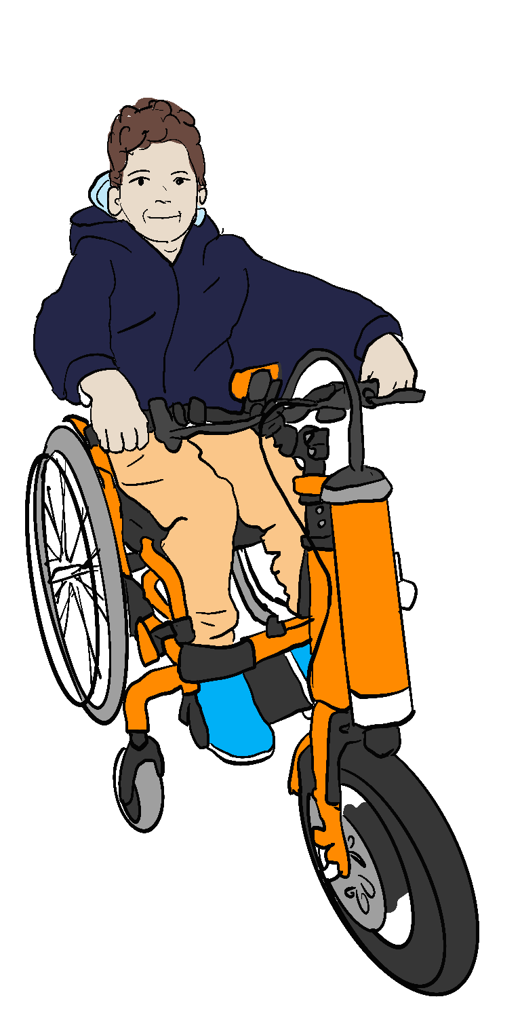
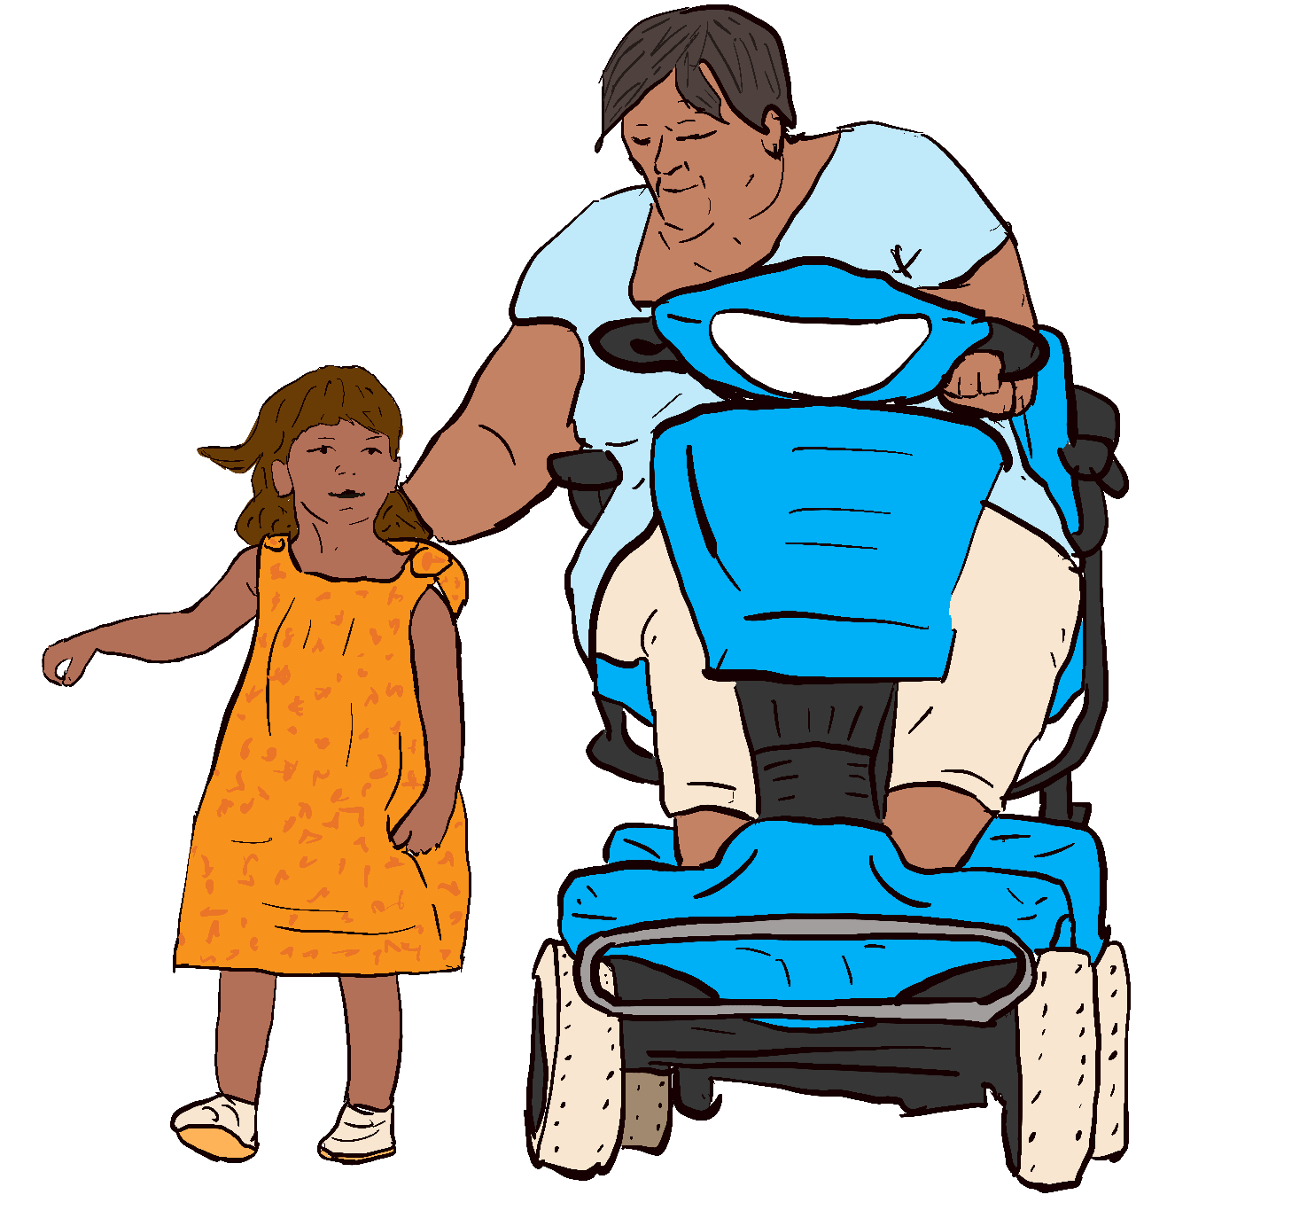

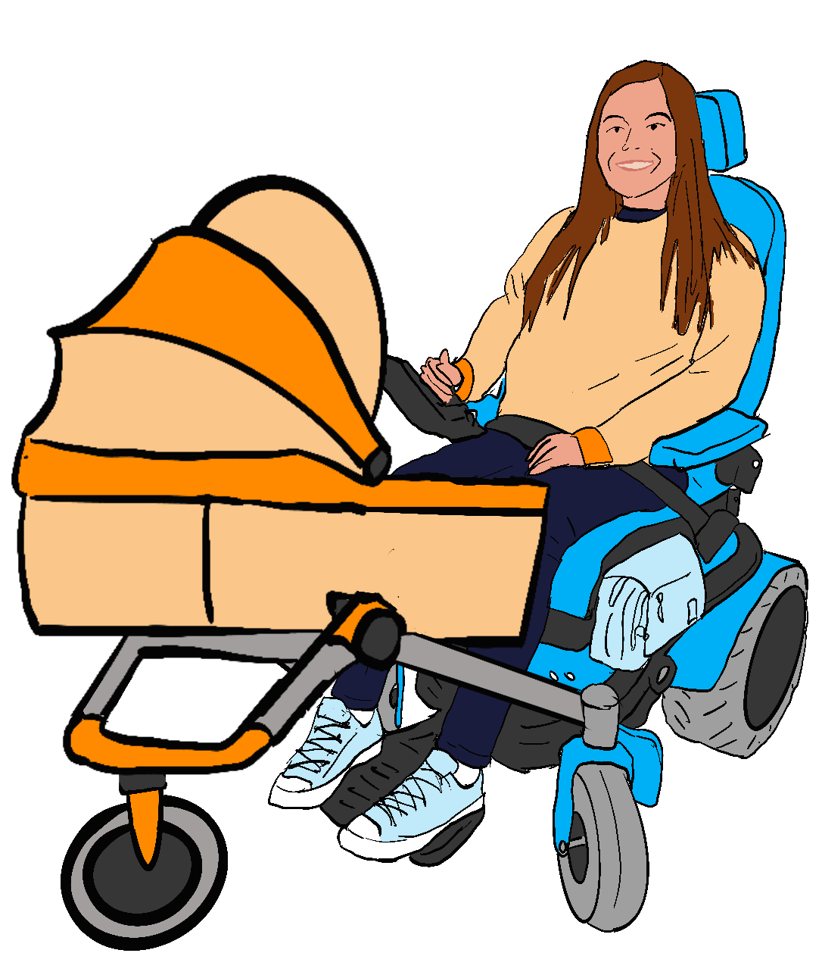
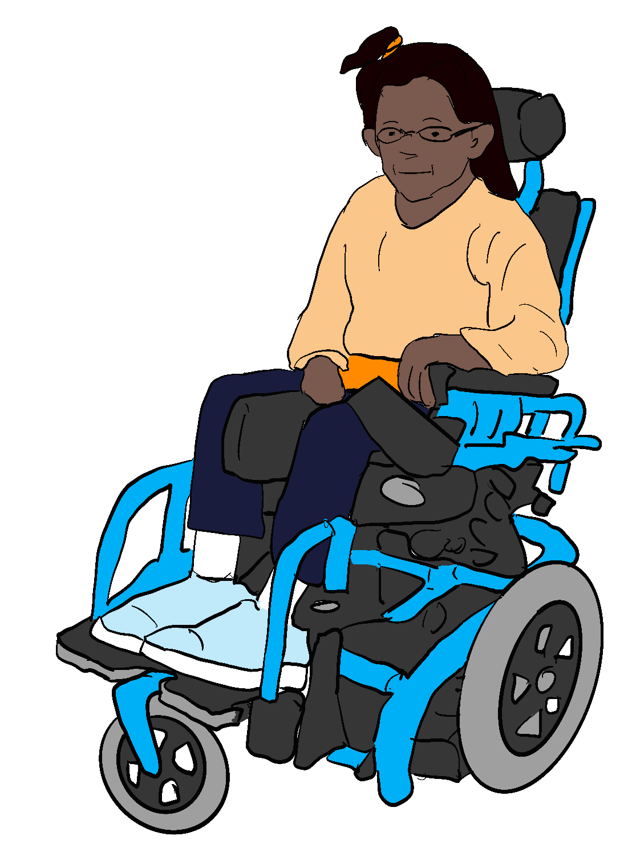
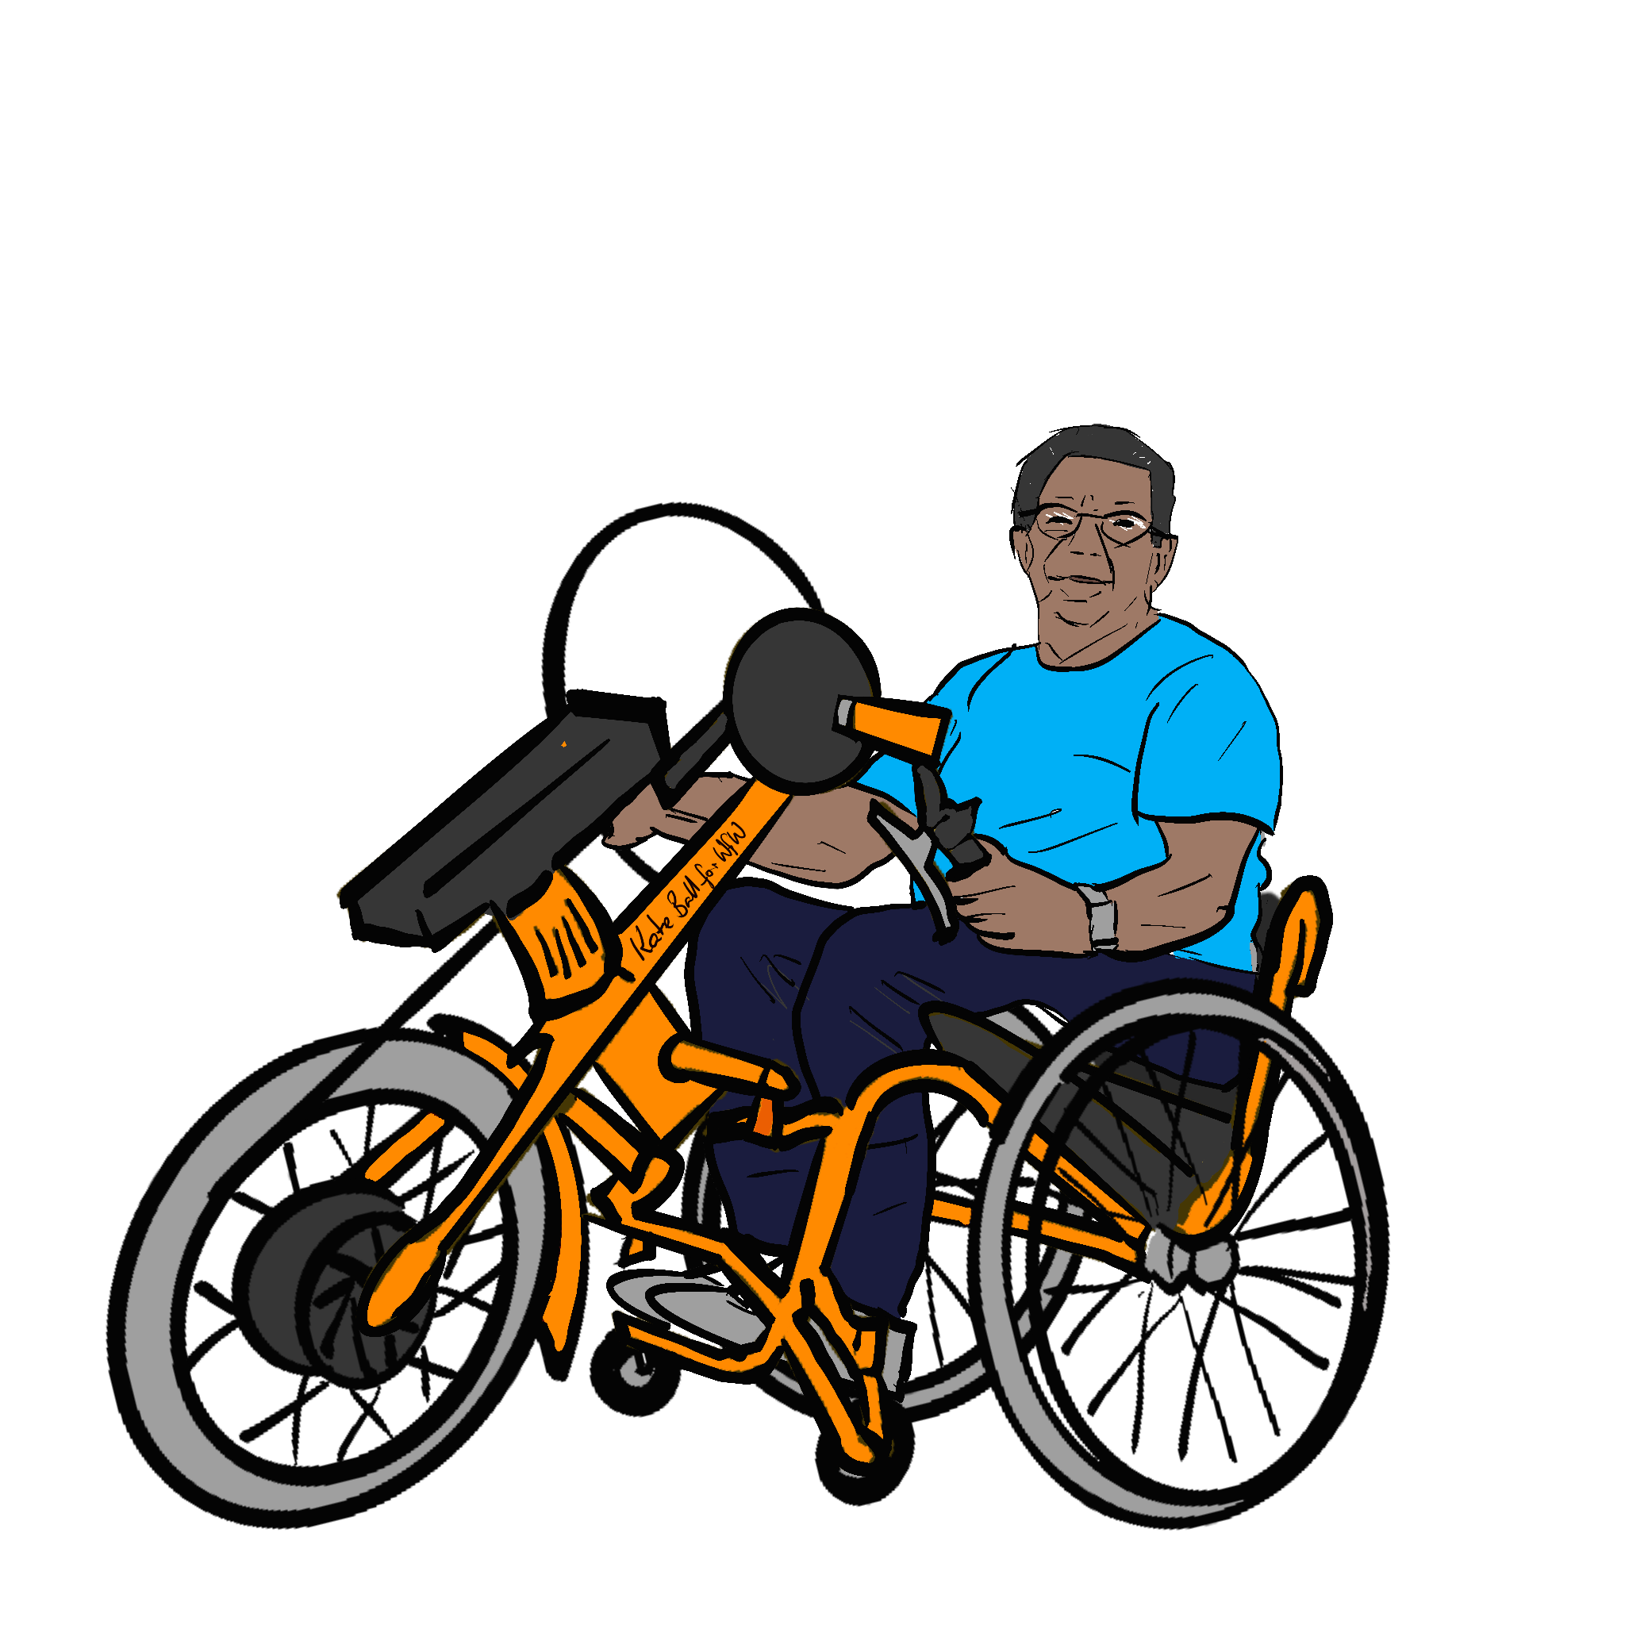

Mobility Justice: How new mobility aid regulations can provide equal mobility rights for all
Wheels for Wellbeing Campaigns and Policy Team

Slide 2

Housekeeping
Chat is going to hosts only, to avoid disrupting access software for attendees. Please submit questions via chat.
This webinar is being recorded:
Please switch your camera off if you don’t want to be recorded.
Please state in text questions if you don’t want questions shared publicly, including on uploaded video of this webinar.
This webinar is scheduled for one hour:
The main presentation will be around 40-45 minutes.
There will be around 15-20 minutes for questions.
If there are a lot of questions, we can extend the webinar by up to 30 minutes for those who want to stay.

Slide 3
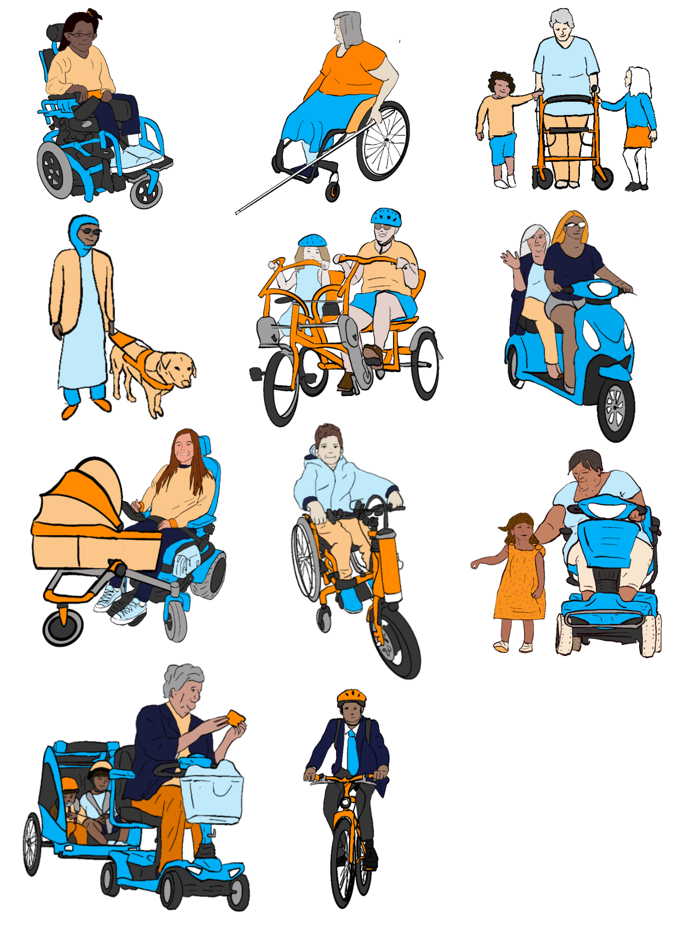
Contents
Equality of access to pedestrian and cycling/cycling-equivalent mobility;
Context: Where we are now, and how we got there;
Achieving mobility for all: What’s needed?
The government “mobility devices” consultation.

Slide 4
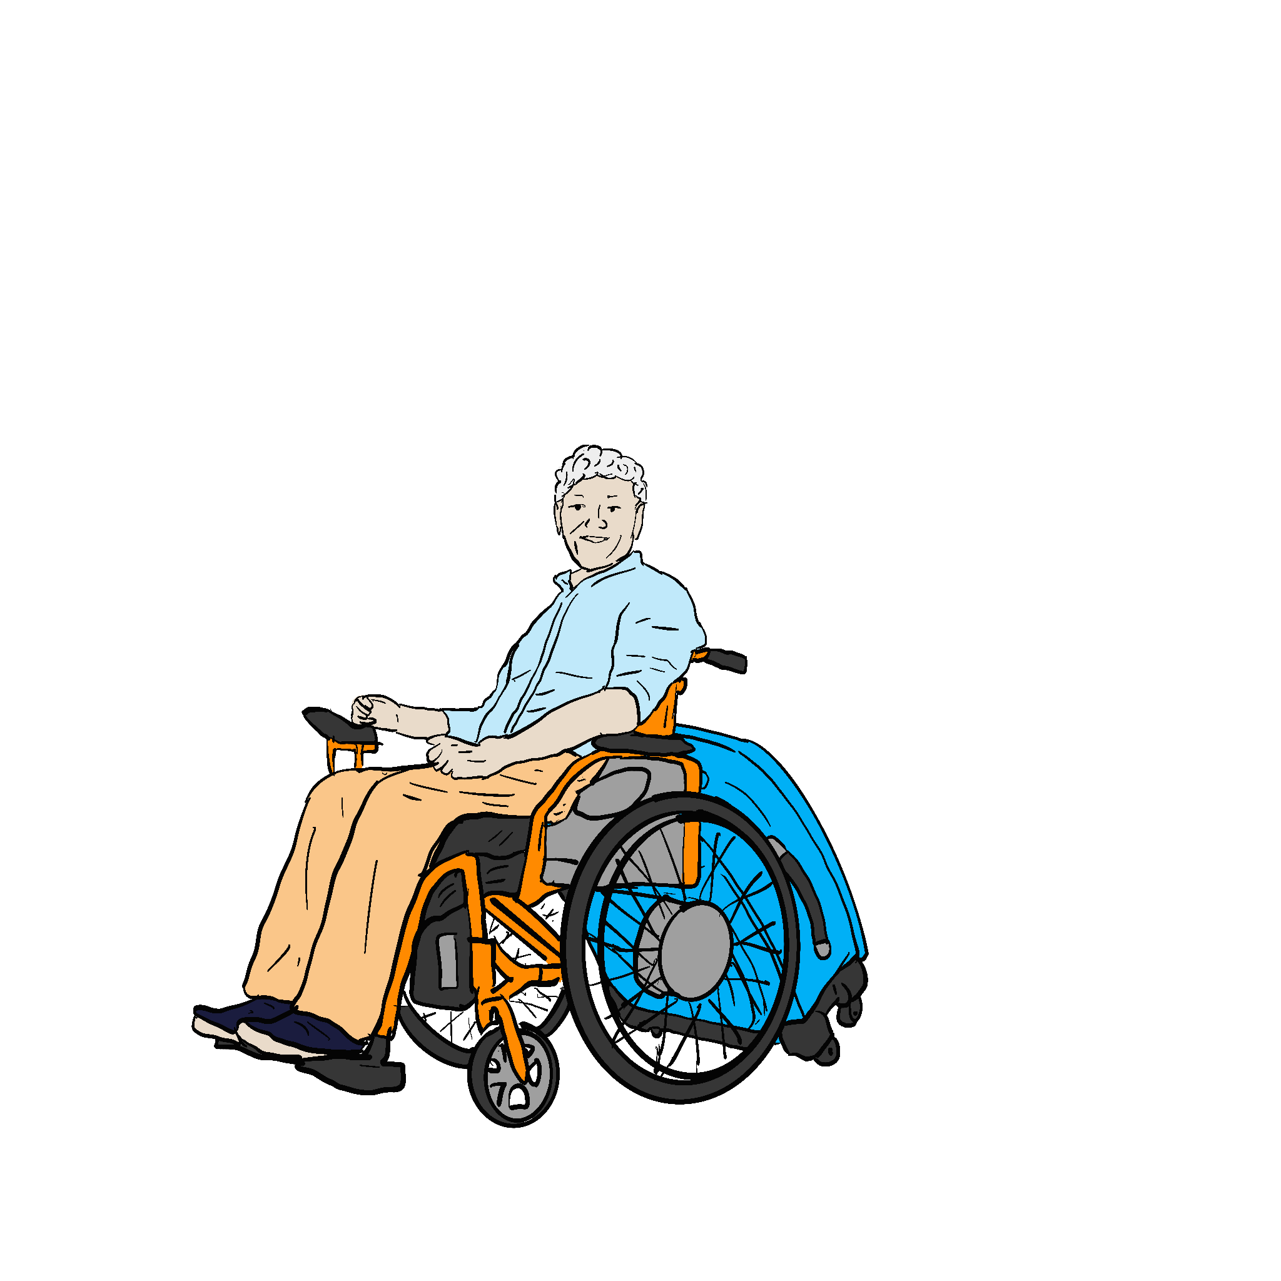
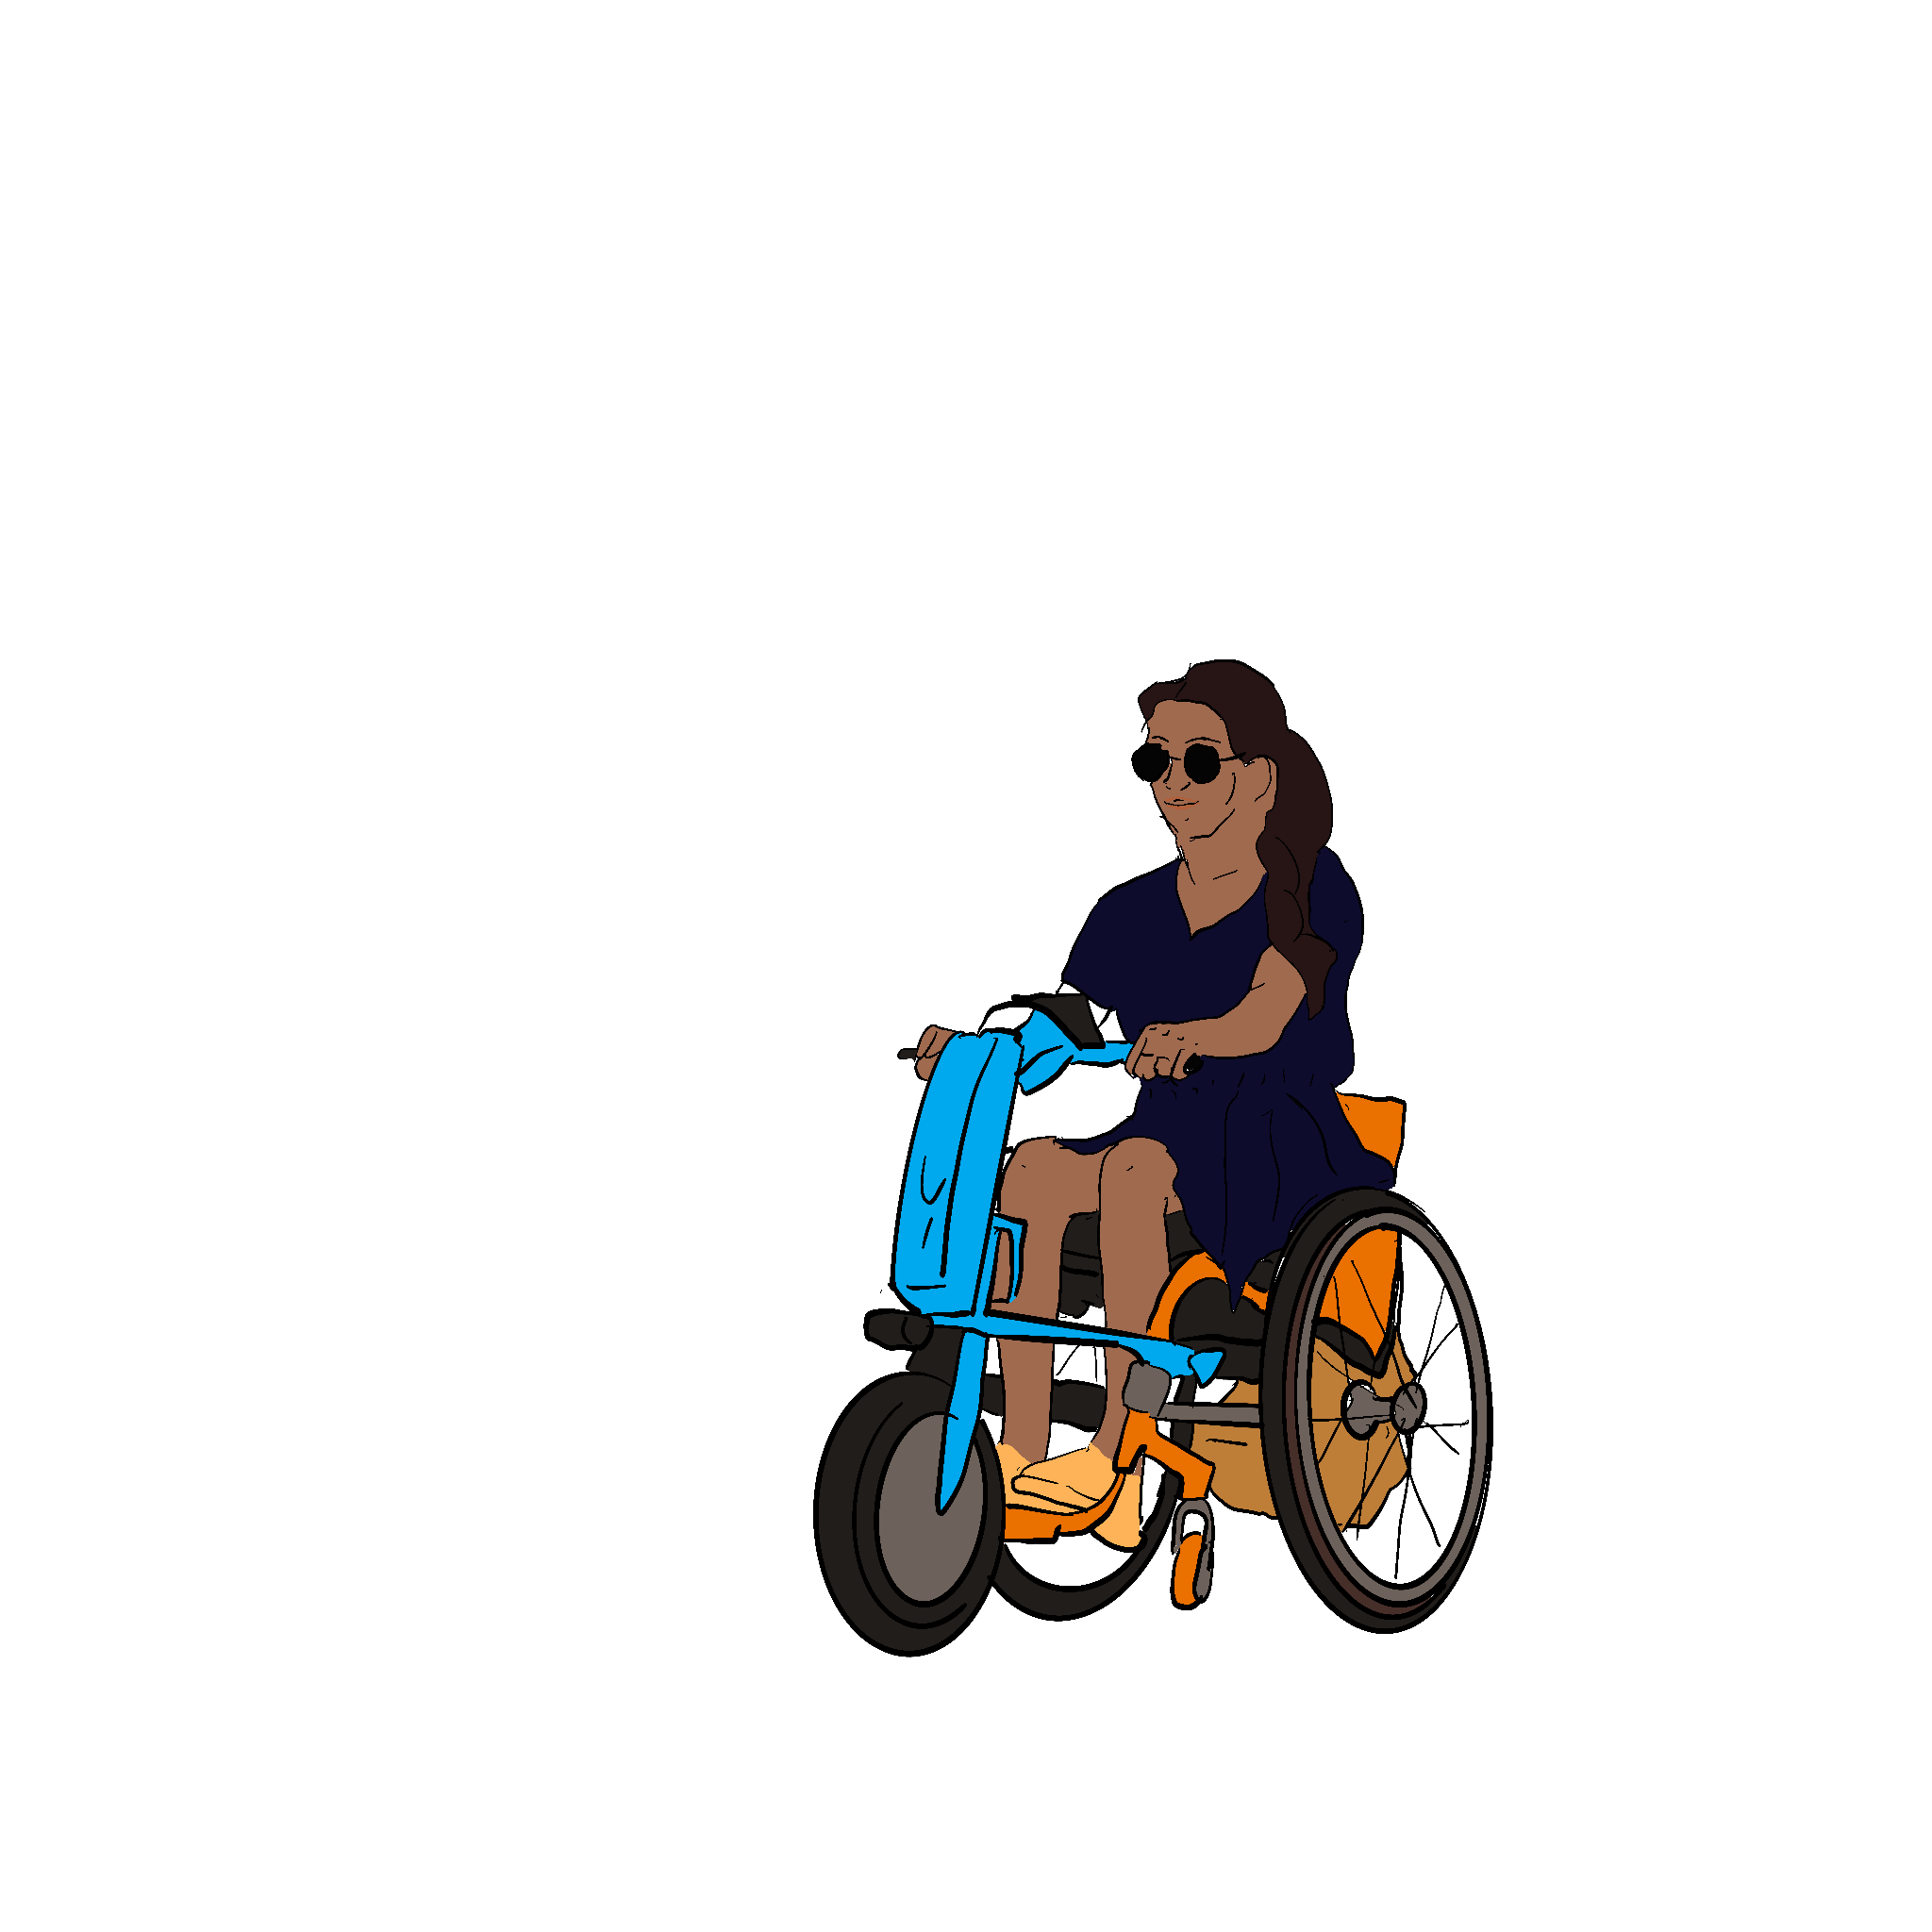
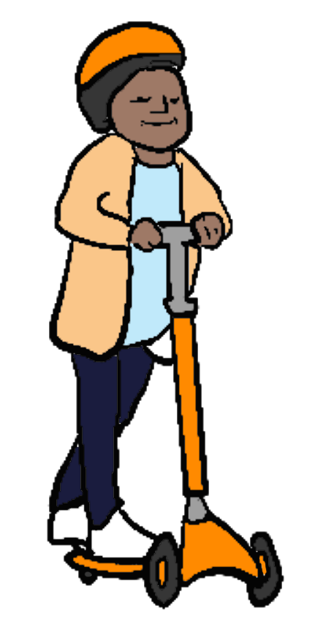
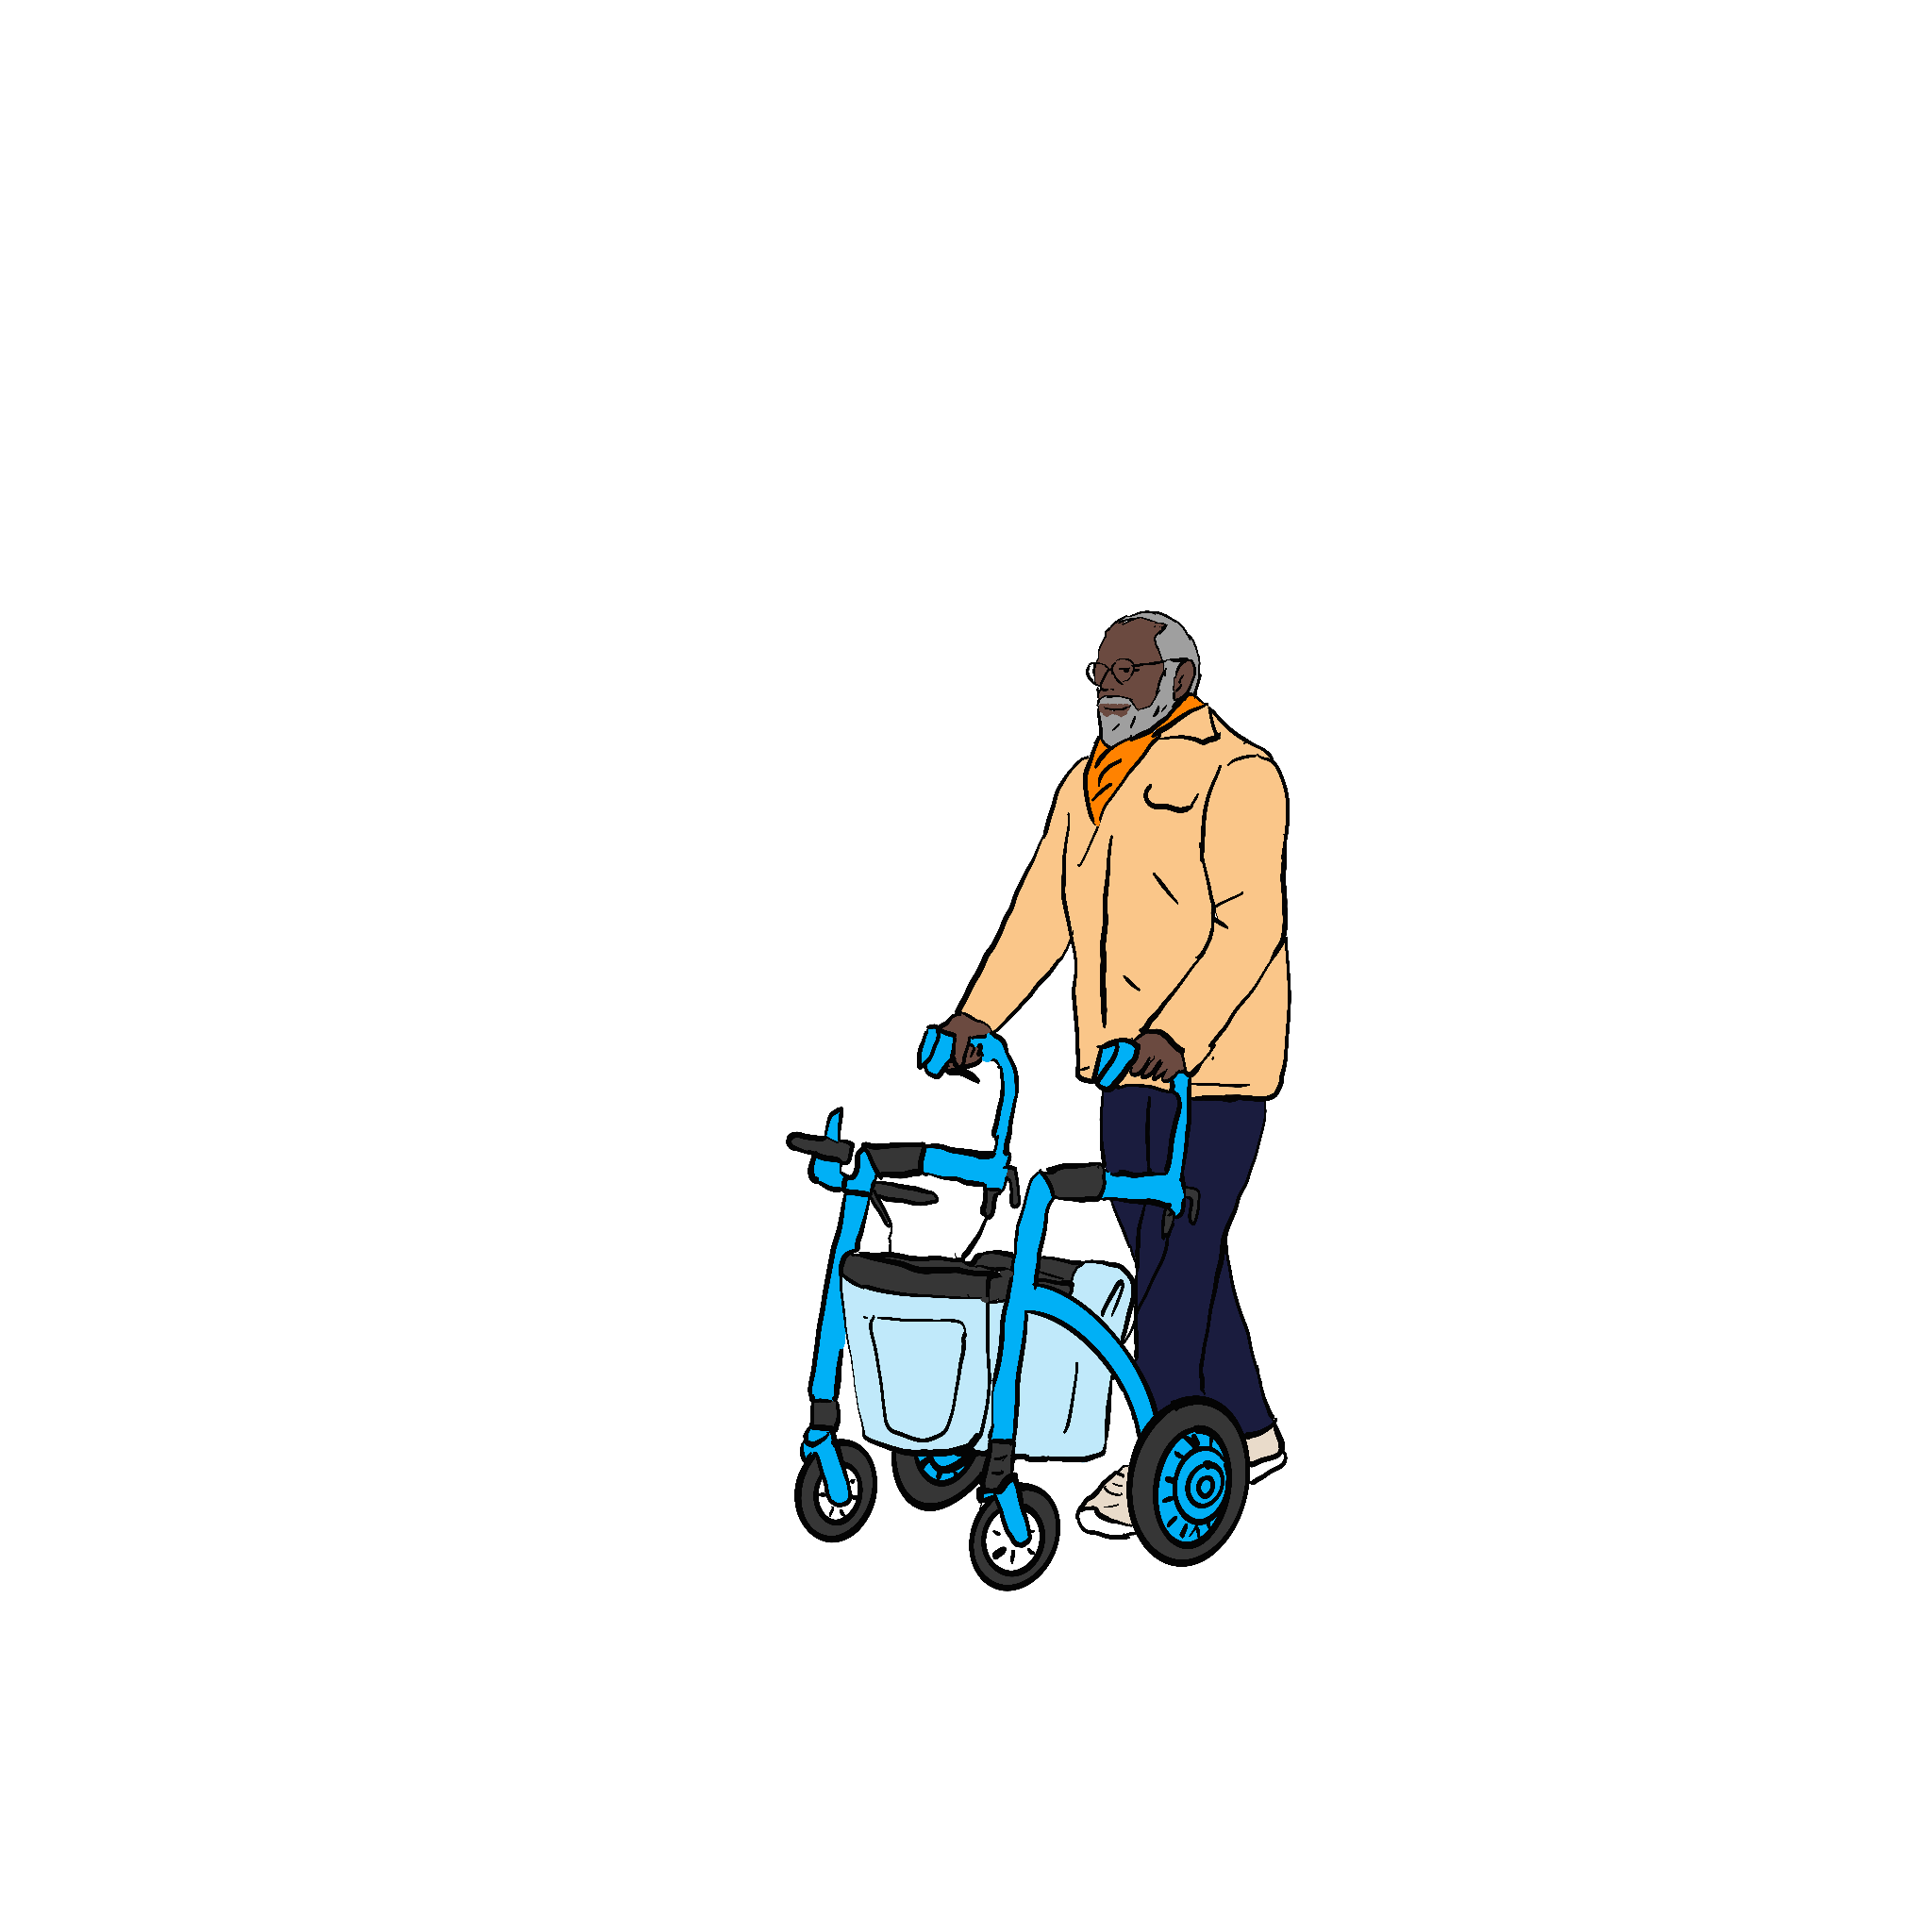
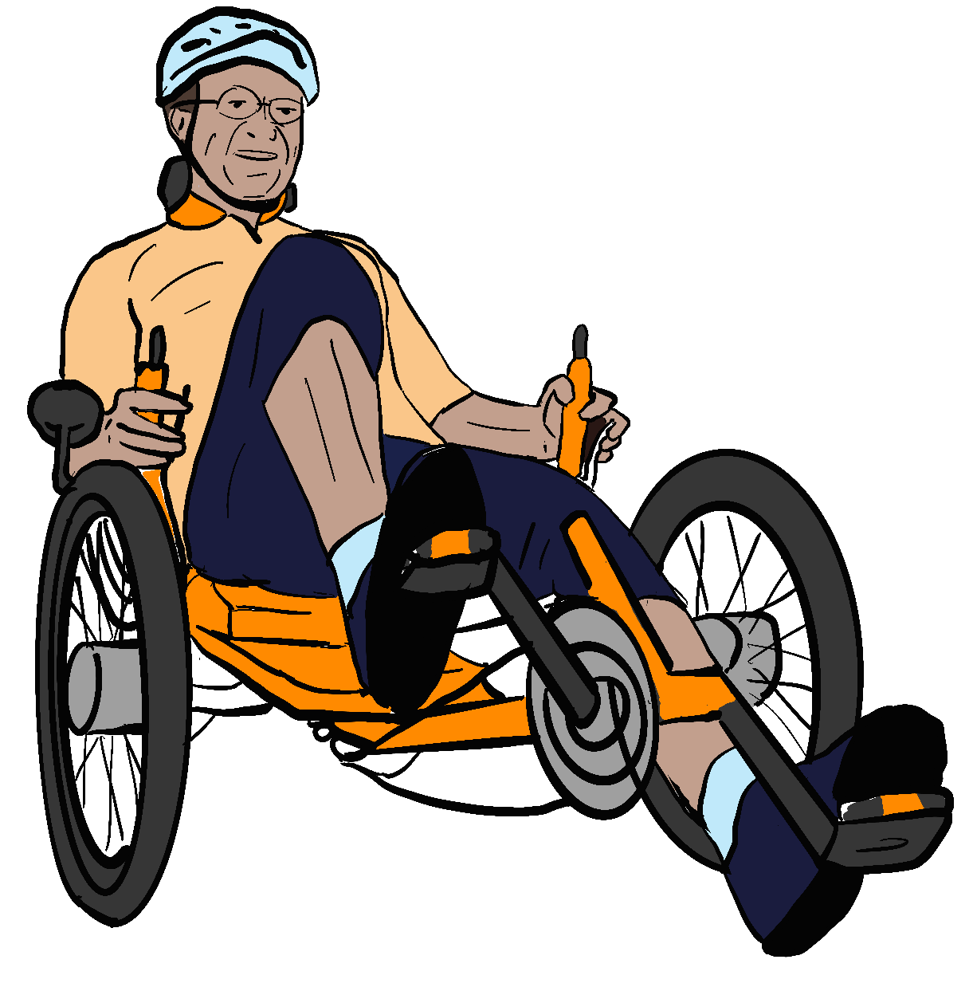
The right to be a pedestrian
Disabled people must be regarded in law as pedestrians while using mobility aids at pedestrian speeds in all pedestrian spaces
Regulations prohibiting dangerous and antisocial behaviour by all pedestrians apply equally to mobility aid users.
We need the right to use aids that enable us to:
Move independently indoors and outdoors, on a wide range of surfaces,
Support family and friends who need help moving around,
Keep up with the people we’re walking/wheeling with,
Transport our children, shopping, luggage and equipment,
Hurry away from danger, or to keep others safe,
Make trips at the same sorts of speeds that non-disabled pedestrians can.

Slide 5
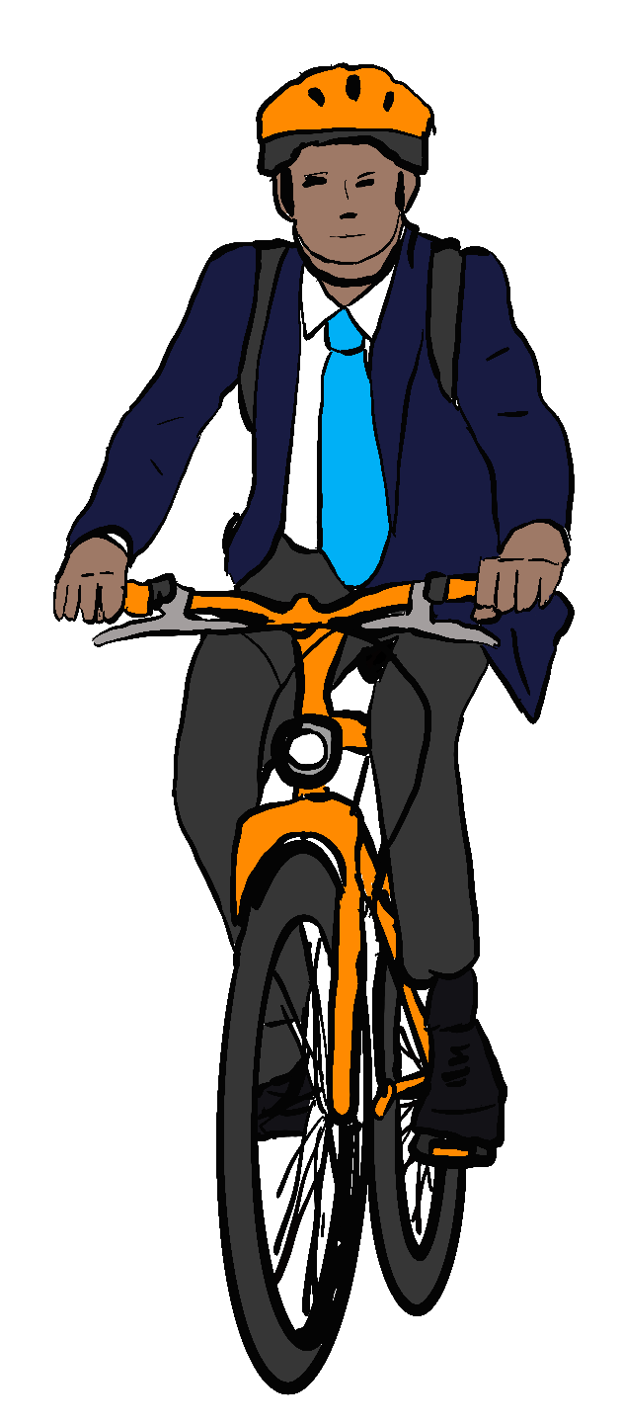
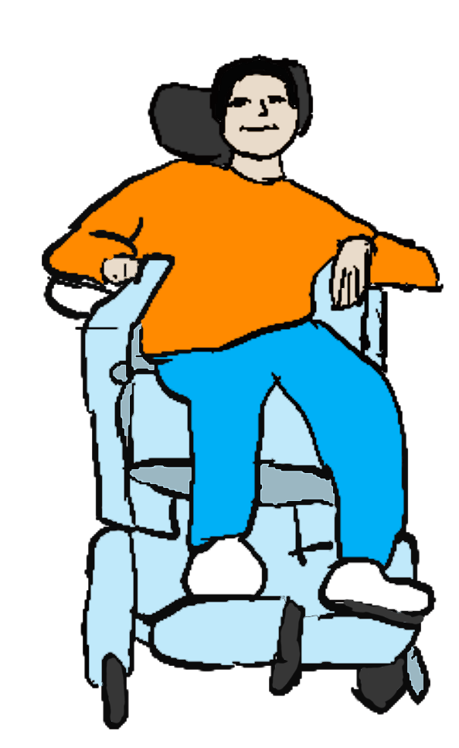
The right to cycling and cycling-equivalent mobility
Disabled people must have the right to use our mobility aids at cycling or cycling-equivalent speeds in all cycle-permitted spaces
Regulations prohibiting dangerous and antisocial behaviour by all cyclists and public space users apply equally to mobility aid users.
We need the right to use aids that enable us to:
Move at pedestrian speeds in pedestrian spaces on aids that are capable of higher speeds,
Support family and friends who need help moving around,
Keep up with the people we’re travelling with,
Transport our babies and children,
Hurry away from danger, or to keep others safe,
Make trips at the same sorts of speeds that non-disabled cyclists and micromobility users can.

Slide 6
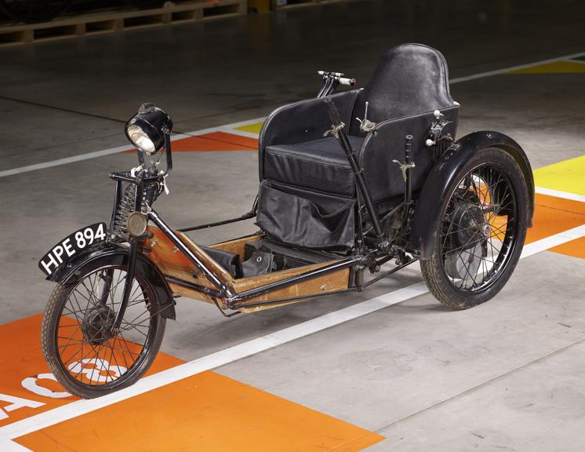
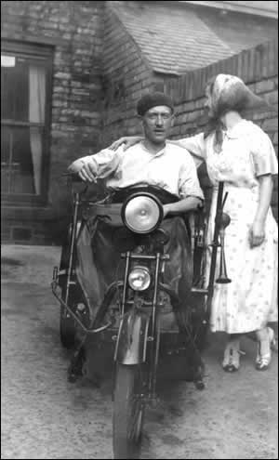
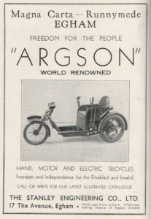
A bit of history – 1930:
1930
Road Traffic Act – 5000+ people per year dying in crashes. This Act removed car speed limits, introduced driving tests solely for Disabled people, created the “invalid carriage” vehicle category: 20mph speed limit, users must be at least 16 and have a driving licence.
“Invalid carriages [are] mechanically propelled vehicles the weight of which unladen does not exceed five hundredweight and which are specially designed and constructed, and not merely adapted, for the use of persons suffering from some physical defect or disability and are used solely by such persons”
1948
1960
1970
1983
1988
1995
2010
2026
Credit: Science Museum
Credit: J Pratt
Credit: Egham Museum

Slide 7
A bit of history – 1948:
1930
Road Traffic Act
1948
NHS founded – Government takes on increased responsibility for providing people with mobility aids
1960
1970
1983
1988
1995
2010
2026

Slide 8
A bit of history – 1960:
1930
Road Traffic Act
1948
NHS founded
1960
Road Traffic Act – Following campaigning by Disabled people who needed multi-person powered mobility aids, the law on “invalid carriages” changed...
“" invalid carriage " means a mechanically propelled vehicle the weight of which unladen does not exceed five hundredweight and which is specially designed and constructed, and not merely adapted, for the use of a person suffering from some physical defect or disability and is used solely by such a person”
1970
1983
1988
1995
2010
2026

Slide 9
A bit of history – 1970:
1930
Road Traffic Act
1948
NHS founded
1960
Road Traffic Act
1970
Chronically Sick and Disabled Persons Act & Use of Invalid Carriages on Highways Regulations – Range of services, led to Motability. For non-motor-vehicle mobility, these laws:
Regulated use of unpowered wheelchairs.
Defined low weight (250lb/113.4kg max), low speed (4mph max powered) single-user devices which could be used without a driving licence.
Gave users of these unpowered and powered wheelchairs/mobility scooters the right to use pavements, footpaths and bridleways as well as roads.
“" invalid carriage " means a vehicle, whether mechanically propelled or not, constructed or adapted for use for the carriage of one person, being a person suffering from some physical defect or disability”
1983
1988
1995
2010
2026

Slide 10
A bit of history – 1983:
1930
Road Traffic Act
1948
NHS founded
1960
Road Traffic Act
1970
Chronically Sick and Disabled Persons Act & Use of Invalid Carriages on Highways Regulations
1983
Electrically Assisted Pedal Cycles Regulations – legalises pedal cycles of any kind with motors up to 250W and maximum powered speed 15mph, including with throttles to 15mph. No driving licence is needed to use e-assist pedal cycles.
1988
1995
2010
2026

Slide 11
A bit of history – 1988:
1930
Road Traffic Act
1948
NHS founded
1960
Road Traffic Act
1970
Chronically Sick and Disabled Persons Act & Use of Invalid Carriages on Highways Regulations
1983
Electrically Assisted Pedal Cycles Regulations
1988
Use of Invalid Carriages on Highways Regulations
Defined unpowered wheelchairs as “class 1” and powered aids from 1970 act as “class 2”.
Introduced class 3 aids, max speed on road only 8mph, minimum age for use 14, no driving licence or insurance.
The one-person and “physical defect or disability” restrictions from 1970 are still active.
Unladen weight limits: class 1 and class 2 113.4kg, class 3 150kg.
1995
2010
2026

Slide 12
A bit of history – 1995:
1930
Road Traffic Act
1948
NHS founded
1960
Road Traffic Act
1970
Chronically Sick and Disabled Persons Act & Use of Invalid Carriages on Highways Regulations
1983
Electrically Assisted Pedal Cycles Regulations
1988
Use of Invalid Carriages on Highways Regulations
1995
Disability Discrimination Act – “invalid carriage” function and use in public spaces did not change. Followed by Public Service Vehicles Accessibility Regulations 2000 (bus accessibility) .
2010
2026

Slide 13
A bit of history – 2010:
1930
Road Traffic Act
1948
NHS founded
1960
Road Traffic Act
1970
Chronically Sick and Disabled Persons Act & Use of Invalid Carriages on Highways Regulations
1983
Electrically Assisted Pedal Cycles Regulations
1988
Use of Invalid Carriages on Highways Regulations
1995
Disability Discrimination Act
2010
Equality Act and Rail Vehicle Accessibility Regulations 2010. Use of Invalid Carriages on Highways (amendment) Acts 2015 allow “necessary user equipment” up to unladen total device weight 200kg on class 3 devices only (England and Scotland) and all “invalid carriages” (Wales).
2026

Slide 14
A bit of history – 2026:
1930
Road Traffic Act
1948
NHS founded
1960
Road Traffic Act
1970
Chronically Sick and Disabled Persons Act & Use of Invalid Carriages on Highways Regulations
1983
Electrically Assisted Pedal Cycles Regulations
1988
Use of Invalid Carriages on Highways Regulations
1995
Disability Discrimination Act (DDA)
2010
Equality Act (EA)
2026
The Situation Today:
First real reconsideration of mobility aid regulations since DDA and EA
Current mobility aid laws deny Disabled people equal access to pedestrian, cycling and cycling-equivalent mobility.

Slide 15
New rules – same old inequality?
Equality Act 2010–
The government are required to make all reasonable adjustments to achieve equality of access for Disabled people. Anticipatory duty – must be done before anyone experiences discrimination.
Public Sector Equality Duty: The government are required to have due regard to the need to advance equality of opportunity for Disabled people.
UNCRPD article 20 Personal Mobility –
“States Parties shall take effective measures to ensure personal mobility with the greatest possible independence for persons with disabilities, including by:
a) Facilitating the personal mobility of persons with disabilities in the manner and at the time of their choice, and at affordable cost;
b) Facilitating access by persons with disabilities to quality mobility aids, devices, assistive technologies and forms of live assistance and intermediaries, including by making them available at affordable cost;”
New mobility aid regulations must be made to meet the requirements of the Equality Act and the United Nations Convention on the Rights of Persons with Disabilities

Slide 16

Grey areas, misunderstandings and bans
Risk from incorrect advice and misunderstandings – e.g. wrong advice on which mobility aids can be used where.
Discrimination – e.g. access refusals onto public transport, taxis, into services.
Enforcement (correct or incorrect) – e.g. confiscation of aids, threat or actual legal action/penalties, physical, mental, financial and social harm.
Safe products aren’t developed – forcing people to take risks and causing harm through reduced mobility e.g. lack of multi-person and child-carrying aids.
New mobility aid rules and associated product standards must be easy to find, written in clear language and freely available to everyone in accessible formats

Slide 17
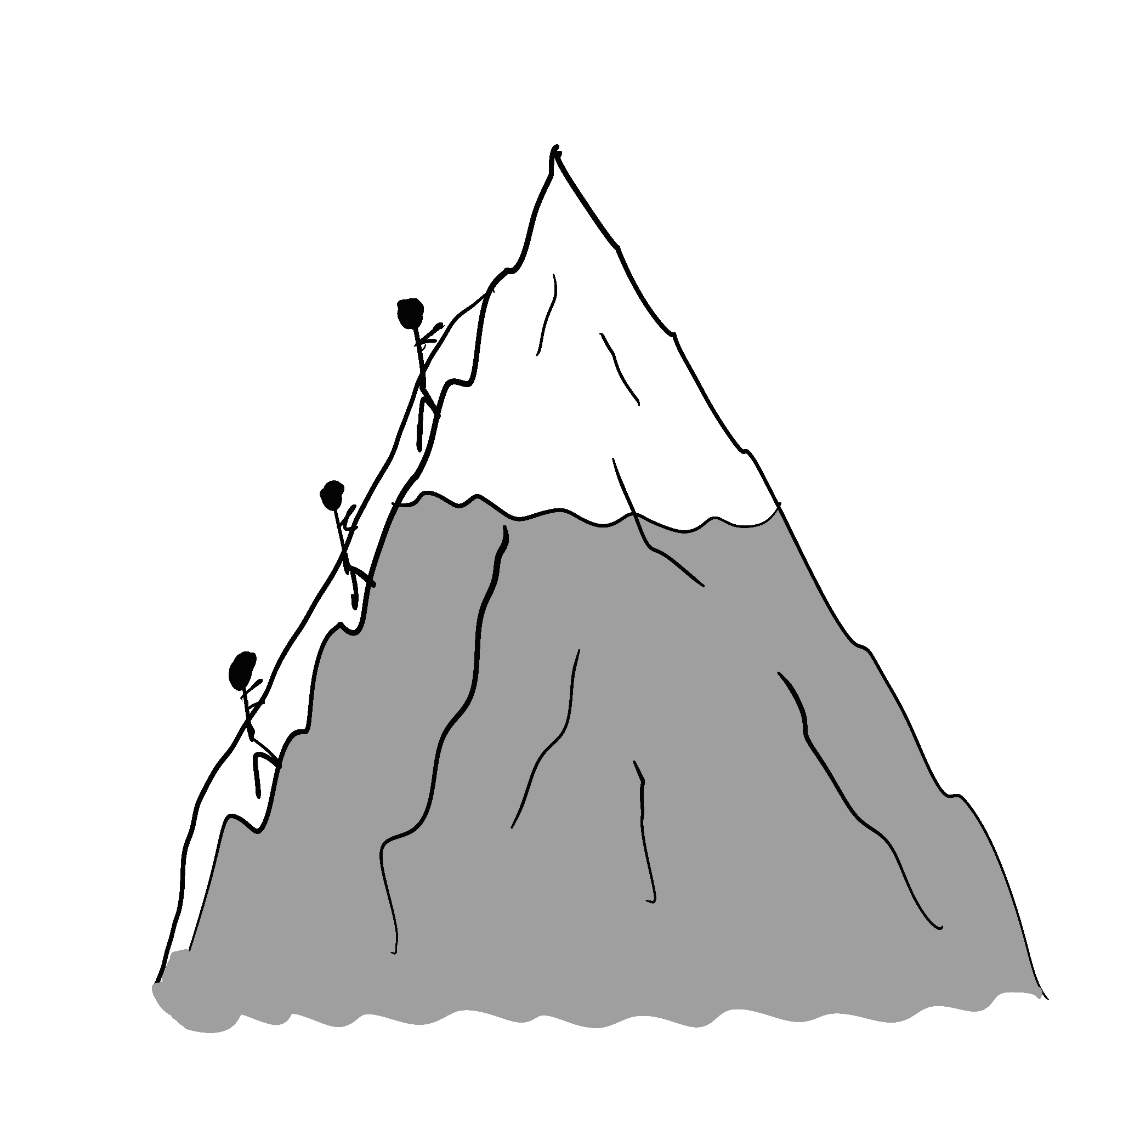

Mobility for all – risks vs benefits
Rights aren’t requirements: A right to do something doesn’t mean anyone has to do that thing – e.g. many people choose not to cycle.
Individual risk-taking often celebrated and incentivised by society: e.g. high-level sports, endurance/adventure activities.
Direct and indirect risks matter: Better mobility aid regulations can help more people become healthier and reduce other risks, e.g. vehicle collisions, isolation.
Vs

Slide 18
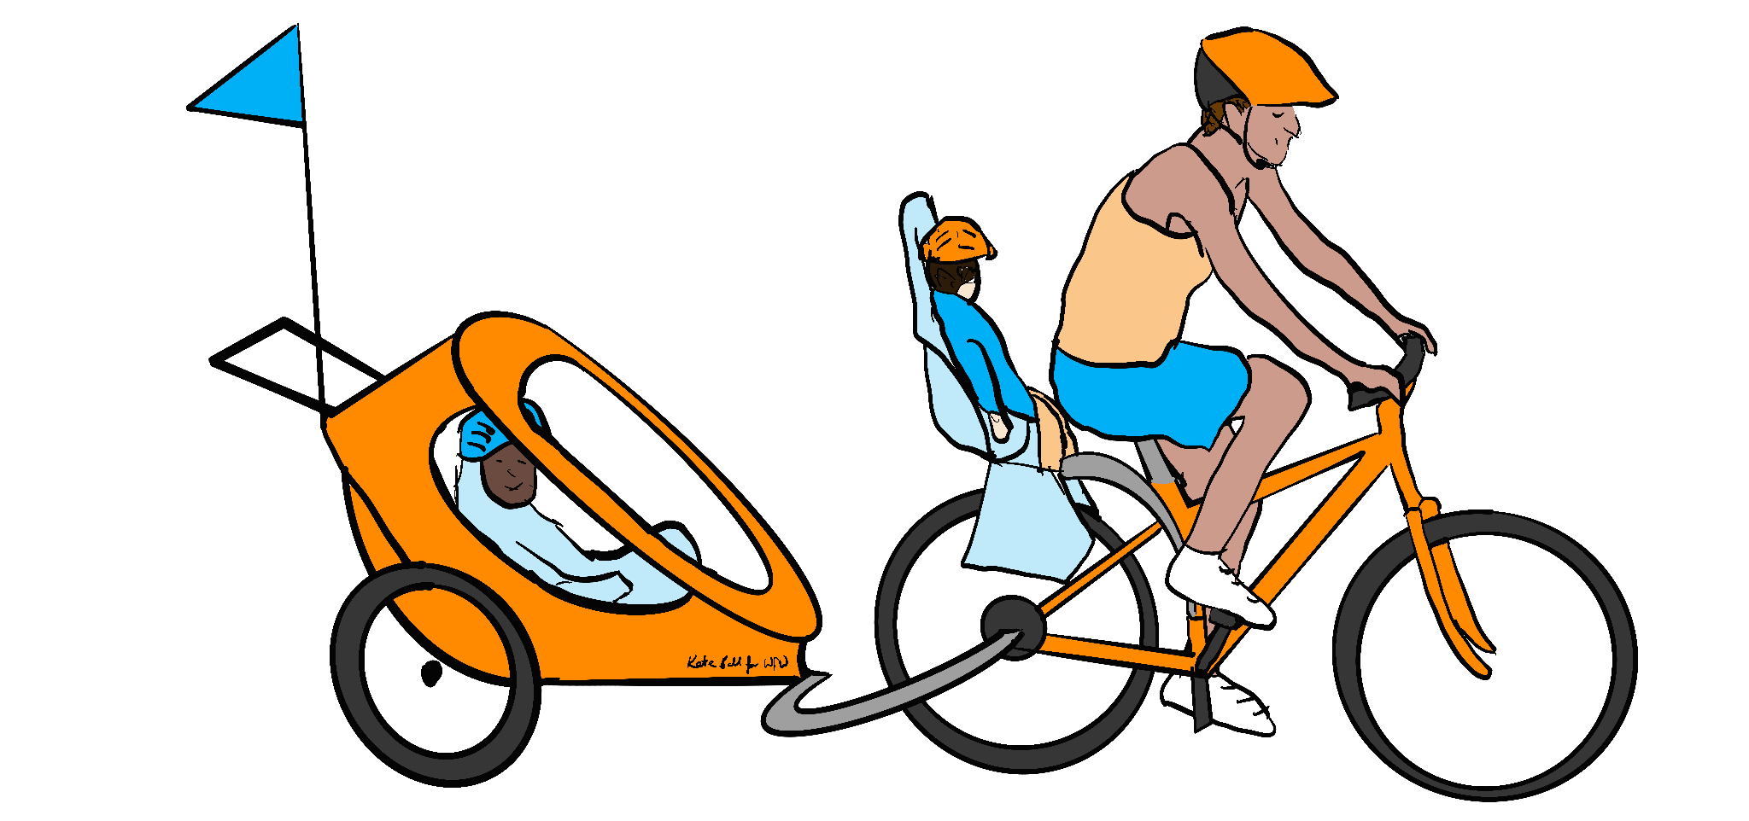
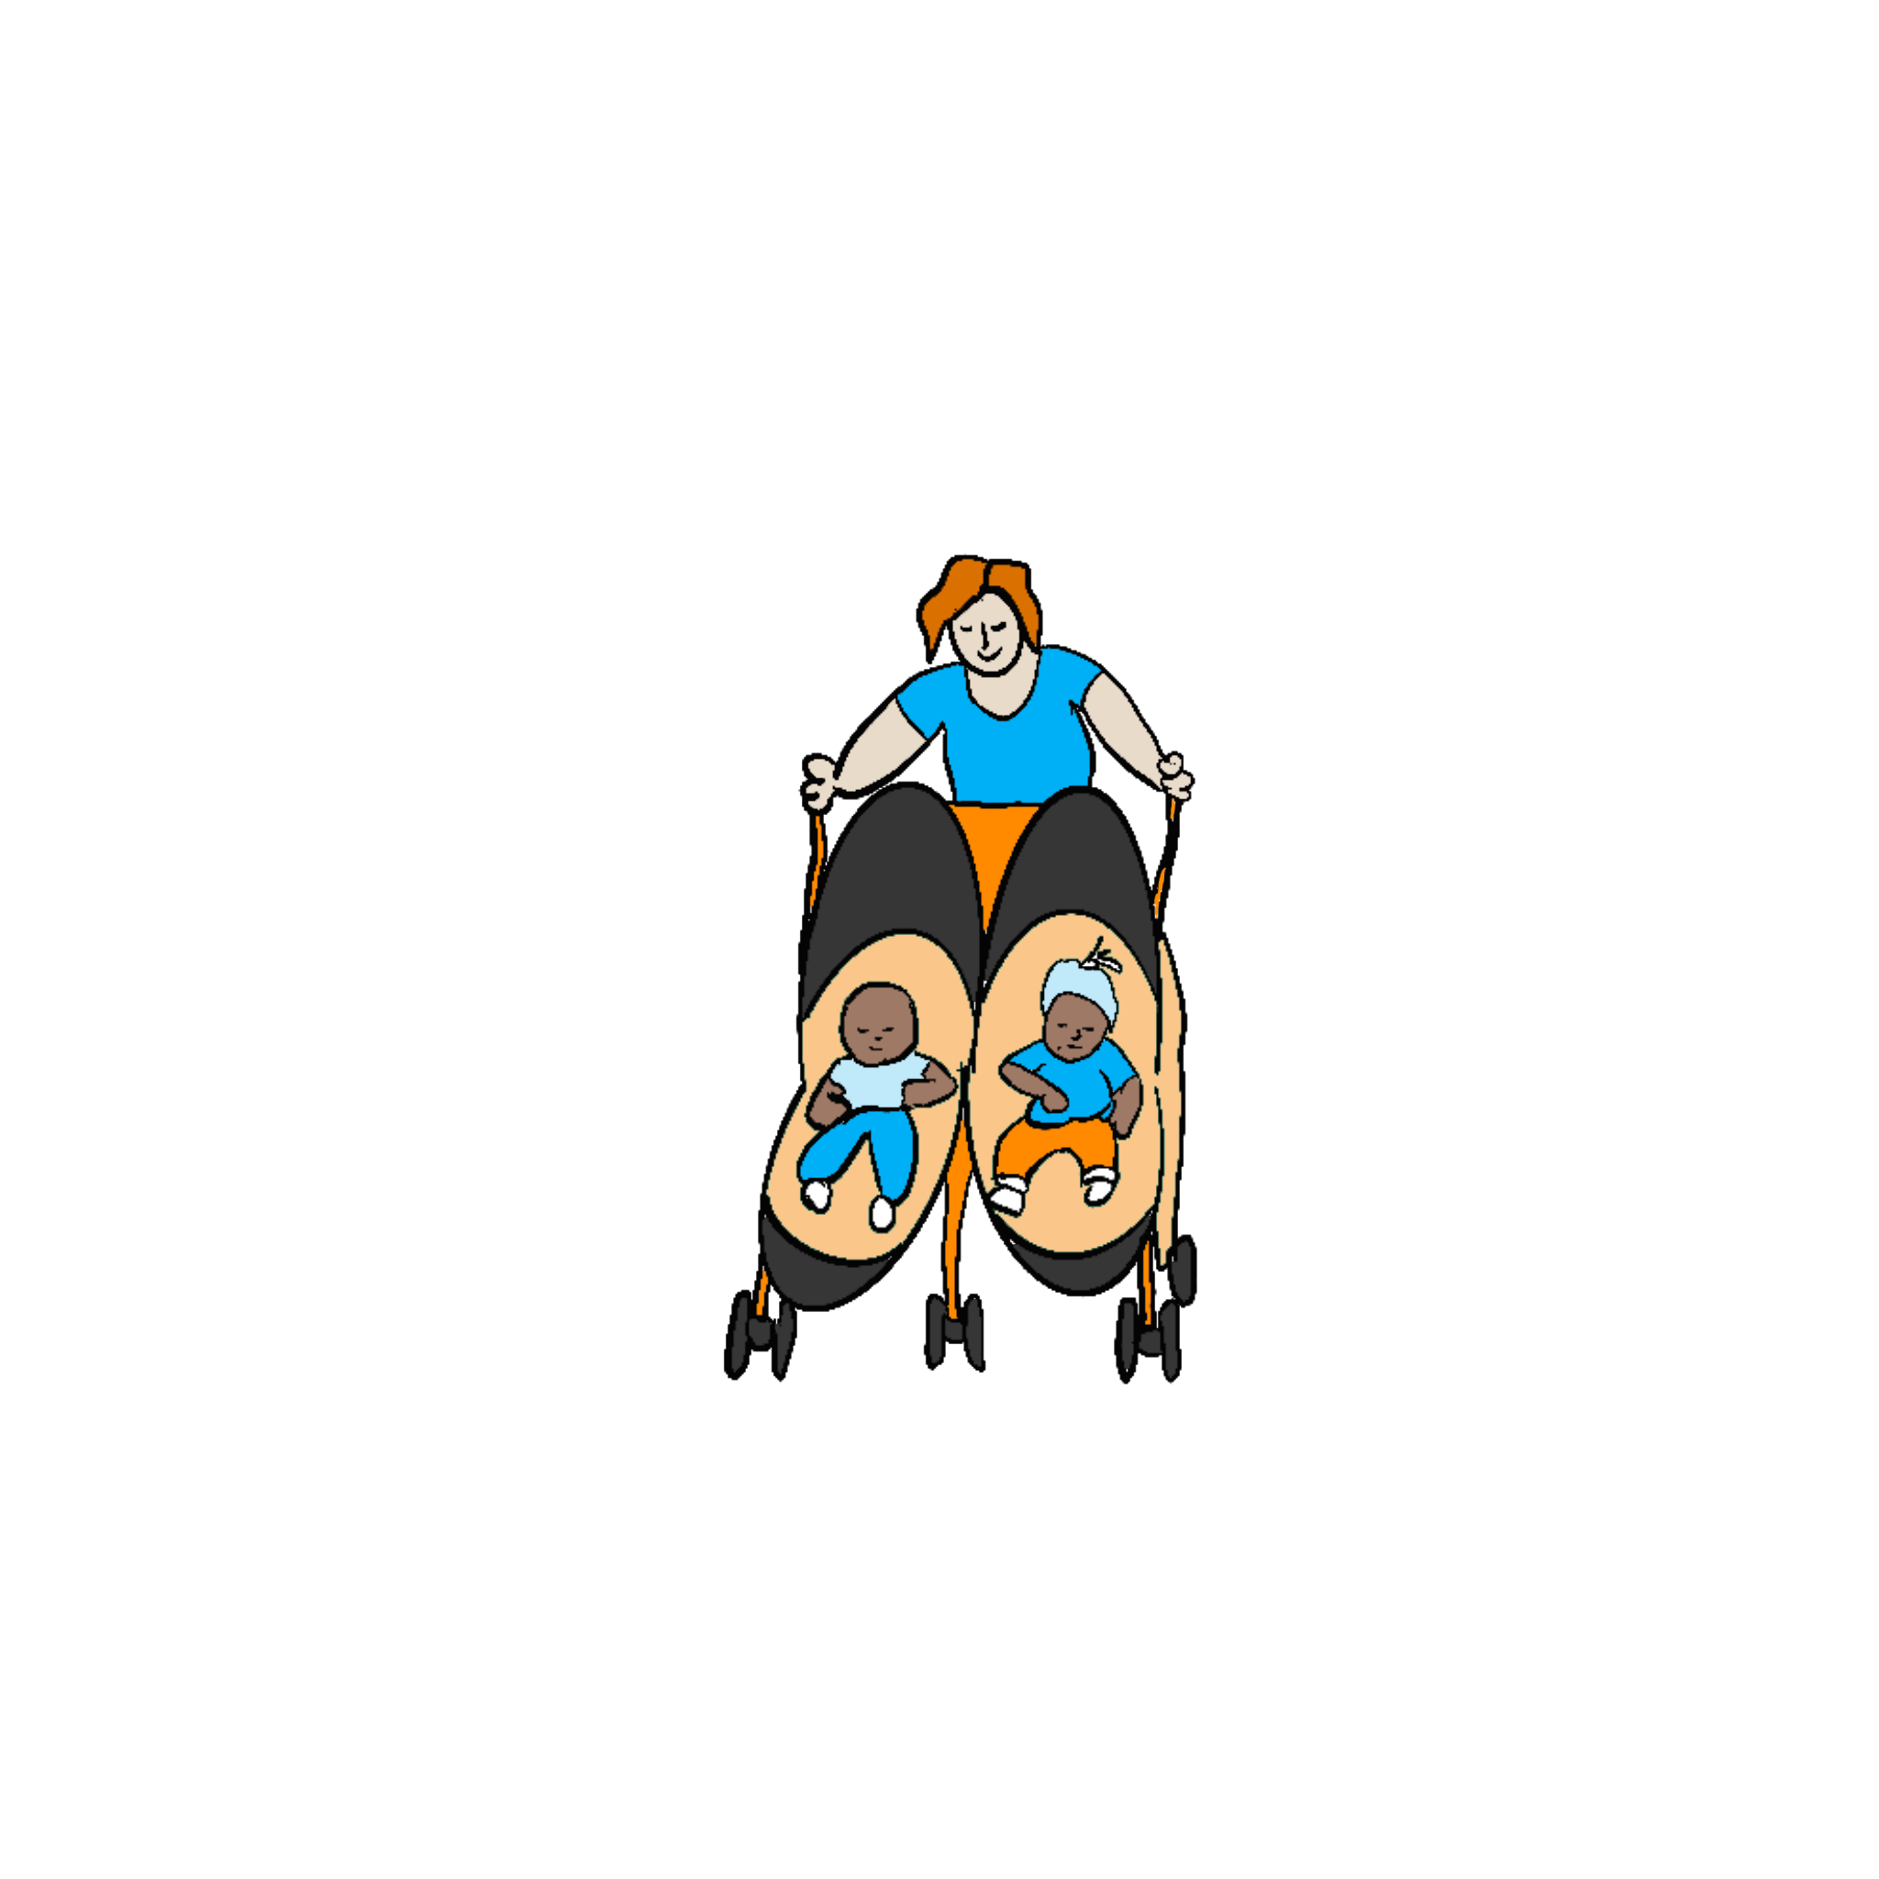
Mobility for all – presumption of capacity
It is discriminatory to prevent a large number of Disabled people from accessing pedestrian and cycling/cycling-equivalent mobility in order to prevent a small number of Disabled and non-disabled people from behaving in ways that put others at risk.
By default, all Disabled and non-disabled people have capacity to make our own decisions.
Parents/carers and professionals judge when children have capacity to make decisions.
If an adult is thought to not have capacity, professionals assess them.
Appointed supporters are responsible for keeping a person who lacks capacity safe and ensuring they don’t endanger others.
If people with capacity behave antisocially or dangerously towards others, then they can and should face civil or criminal penalties for their behaviour.

Slide 19
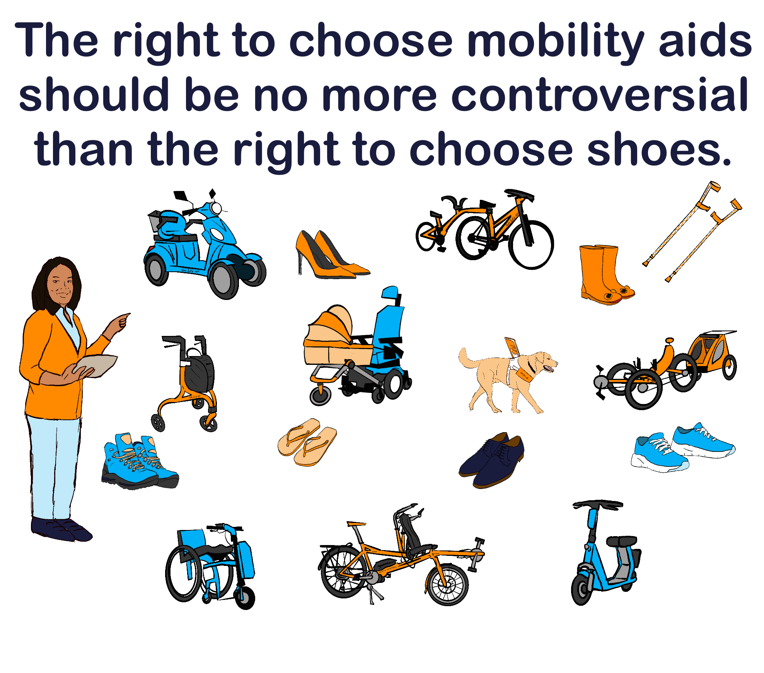
Mobility for all – relevance of impairments
Safe powered and/or unpowered aids can be used by everyone:
Multi-person aids – e.g. tandems, triplets, transporters;
Supported-use aids – e.g. connection in “trains”;
Collision and hazard avoidance technology;
Requiring tests or excluding any group of Disabled people from powered aid use would exclude some people from all mobility.
There must be no legal restrictions to mobility aids based on impairments.

Slide 20
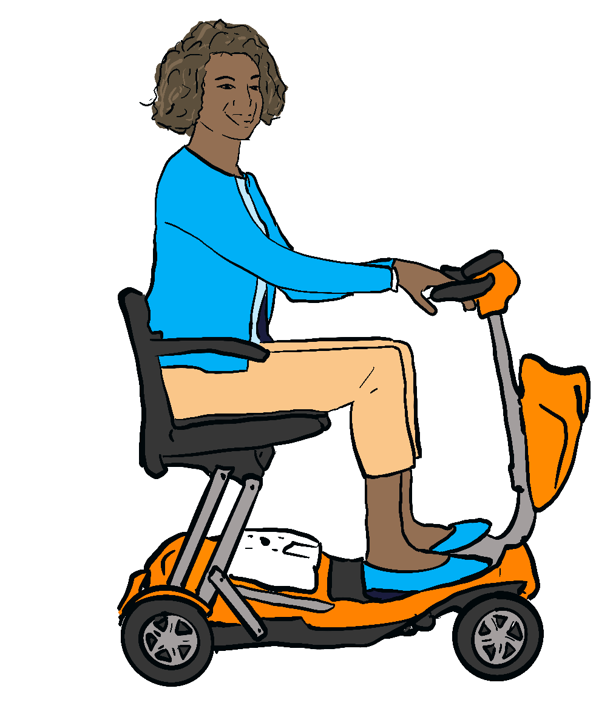
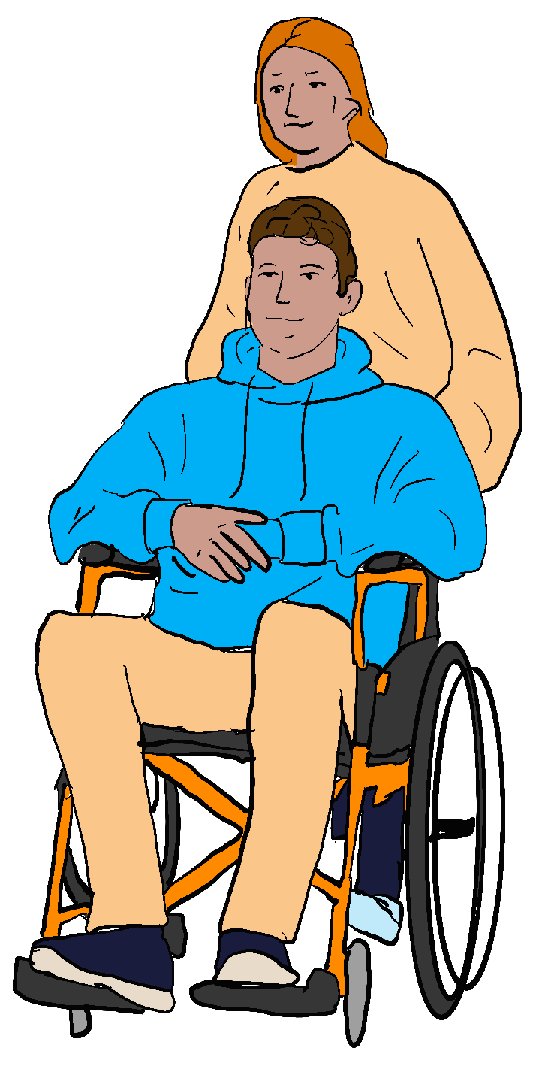
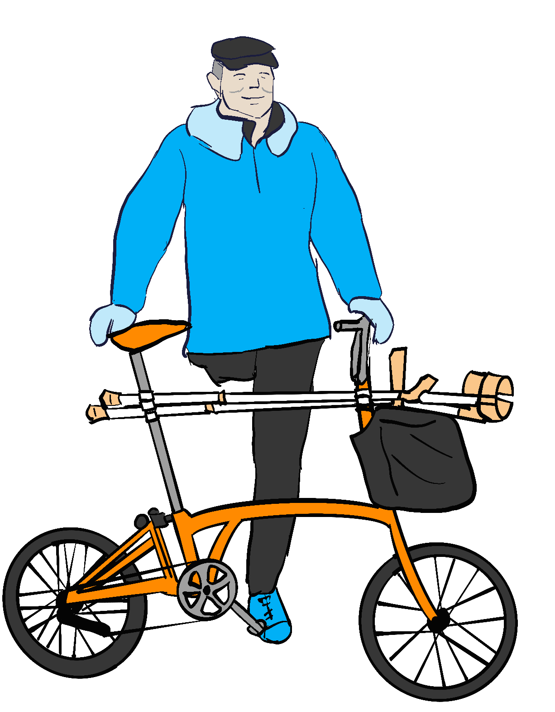
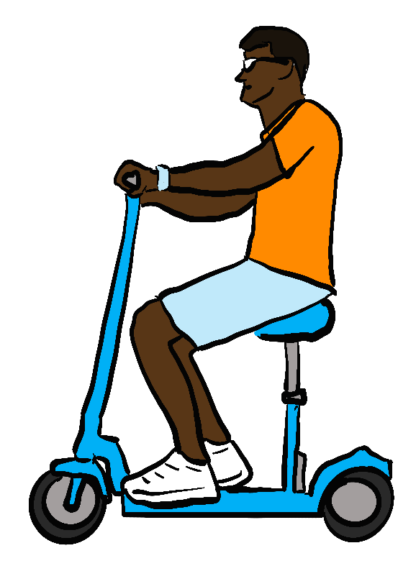
Mobility for all – disability status
“Invalid carriages” are restricted to Disabled/mobility impaired people only. Comparable devices are not formally recognised as mobility aids:
Limits access to practical, cost-effective mobility and physical activity – e.g. cycles and micromobility.
Stigma associated with use – abuse risk, harm through avoidance of use.
Non-disabled people who need to use devices for mobility are barred from use.
Market kept artificially small – prices kept high, innovation, quality and diversity is stifled.
Allow Disabled and non-disabled people to use all legal devices
Give pedestrian access rights and VAT exemptions only to Disabled people using devices as mobility aids

Slide 21
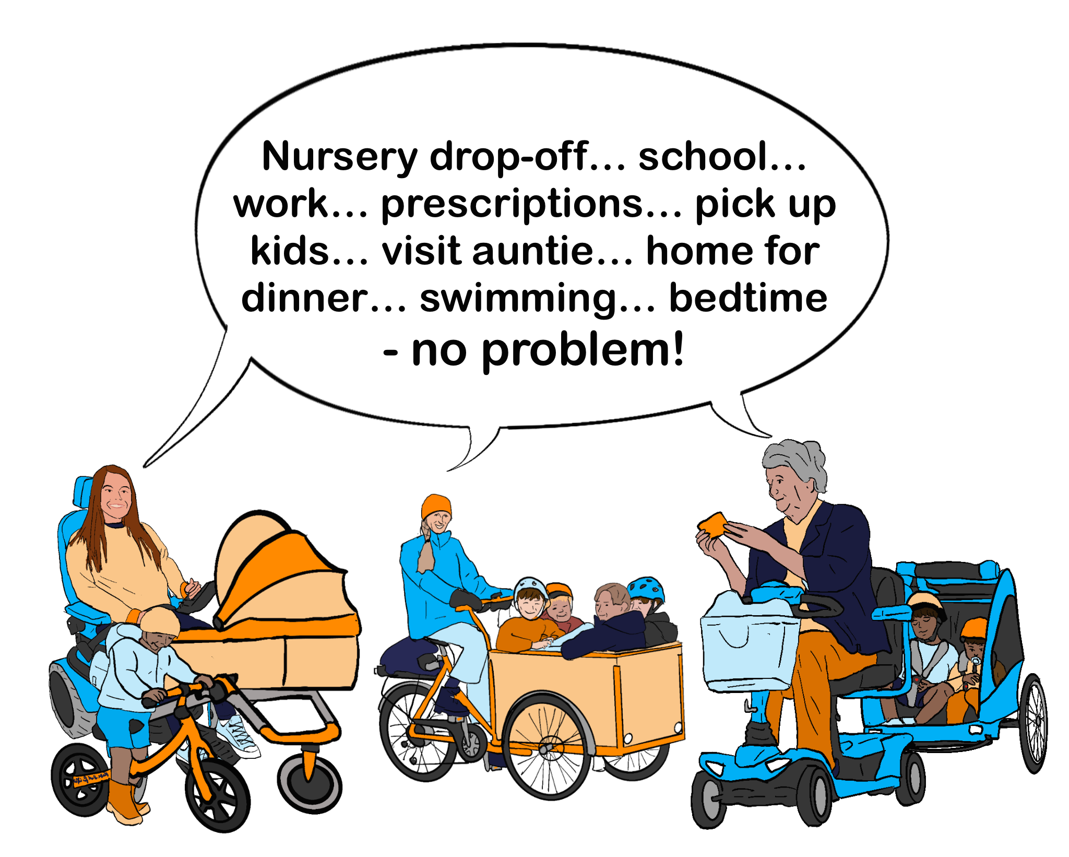
Mobility for all - age
Young people – play, learning, independence. Journey-making with family, friends and alone, moving on uneven/soft surfaces.
Working-age people – trip chaining, time constraints, caring responsibilities.
Older people – caring responsibilities, fewer mobility options, needing to stop driving, maintaining independence.
Remove age, passenger number and cargo/towing restrictions.
Allow cycling/micromobility-equivalent powered speeds.

Slide 22
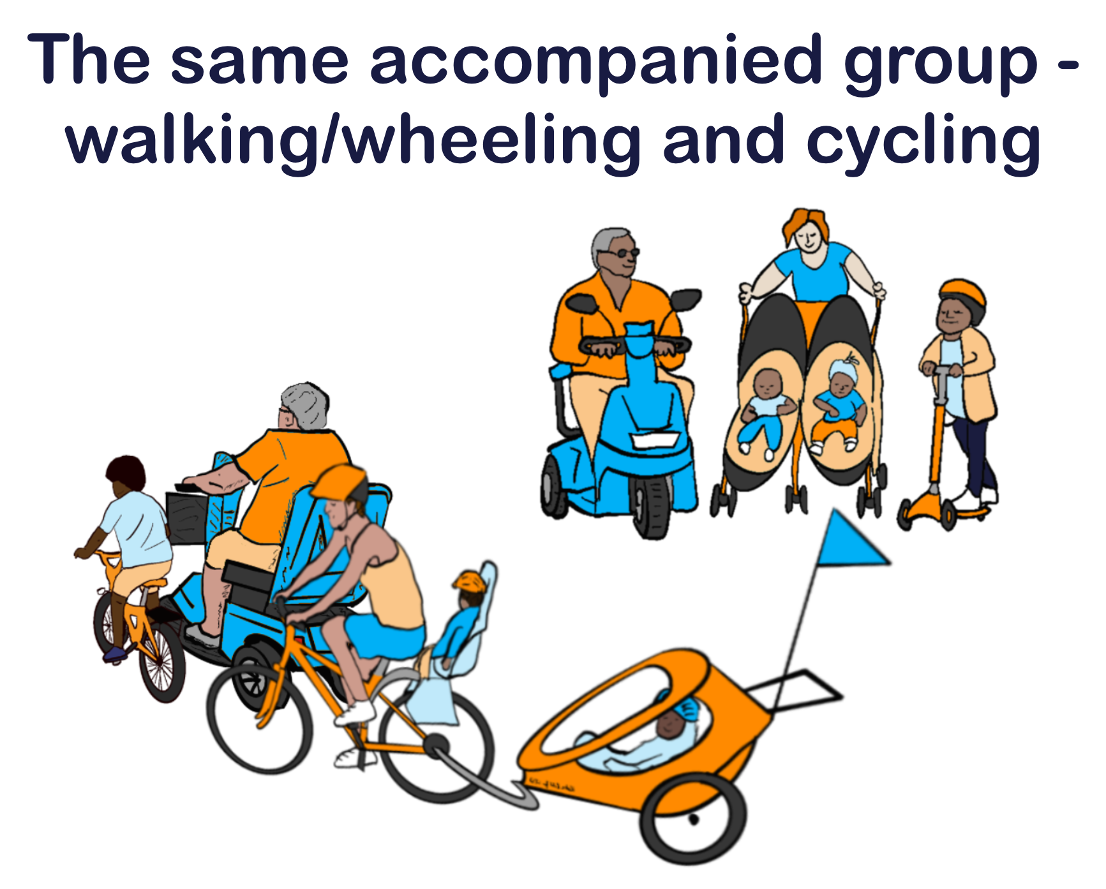
Mobility for all – moving in groups
Accompanied groups – where a group cannot safely split up, due to combined needs of group members.
Mobility aid users need to move with other group members on all pedestrian and cycle-permitted spaces.
E.g. staying with children, Disabled people with different support needs travelling together.
Group sizes equivalent to those supported by driving – from 2 to around 8 people.
Moving in pedestrian and cycling-equivalent groups is essential for many Disabled people to make active journeys.

Slide 23
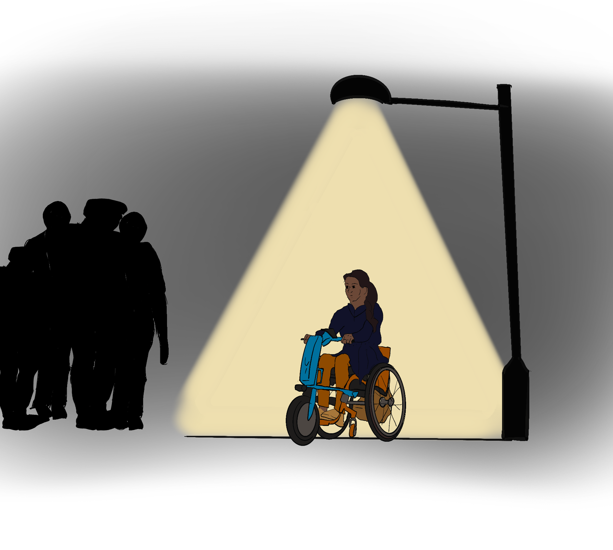
Mobility for all – public space rules
Disabled and non-disabled people need to:
Complete trips at comparable speeds;
Move at safe speeds for the location we are in;
Leave mobility devices in safe locations;
Use judgement to keep ourselves and others safe.
Mobility aid users are already trusted to slow to appropriate speeds of 1-2mph or less in busy spaces like shopping centres, train stations, and inside venues.
Apply the same rules on antisocial and dangerous behaviour in public spaces to mobility aid users that apply to all Disabled and non-disabled people.

Slide 24
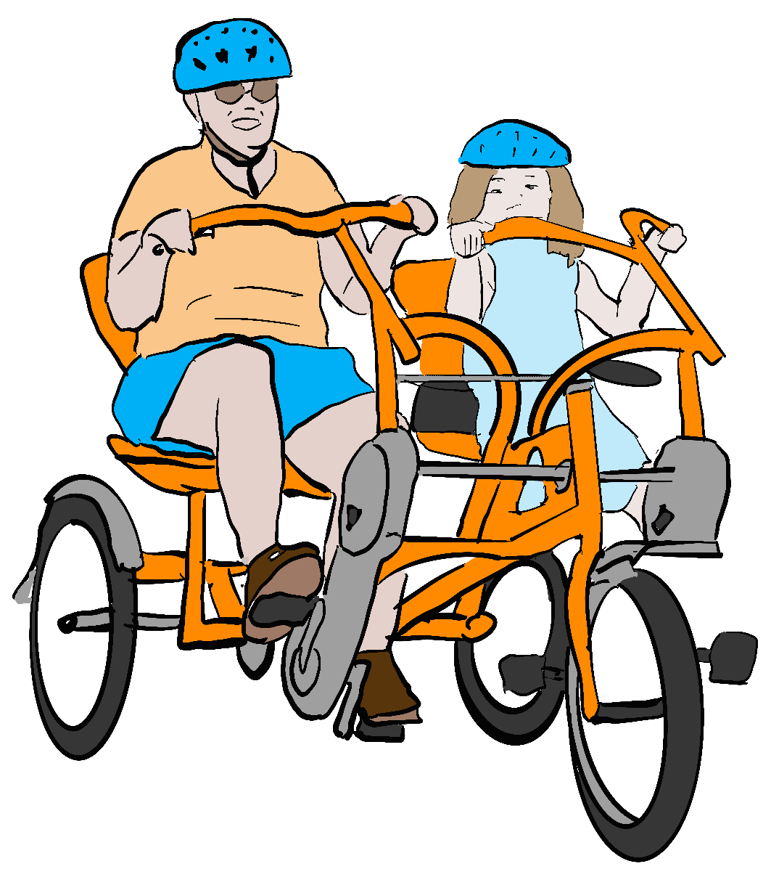
Mobility for all – device specifications for access
Least-restrictive, future-proof regulations:
Maximum weights – ramps/lifts/vehicles
Maximum dimensions for access (more than one device class needed - “all spaces”, “public transport”, “outdoor”)
Maximum speeds
Maximum acceleration
Braking requirements
Lighting requirements (at night)
No unnecessary or over-specific criteria
Mobility device requirements should be comparable to requirements for all other pedestrians or, where appropriate, for cycles/cycling-equivalent devices.

Slide 25
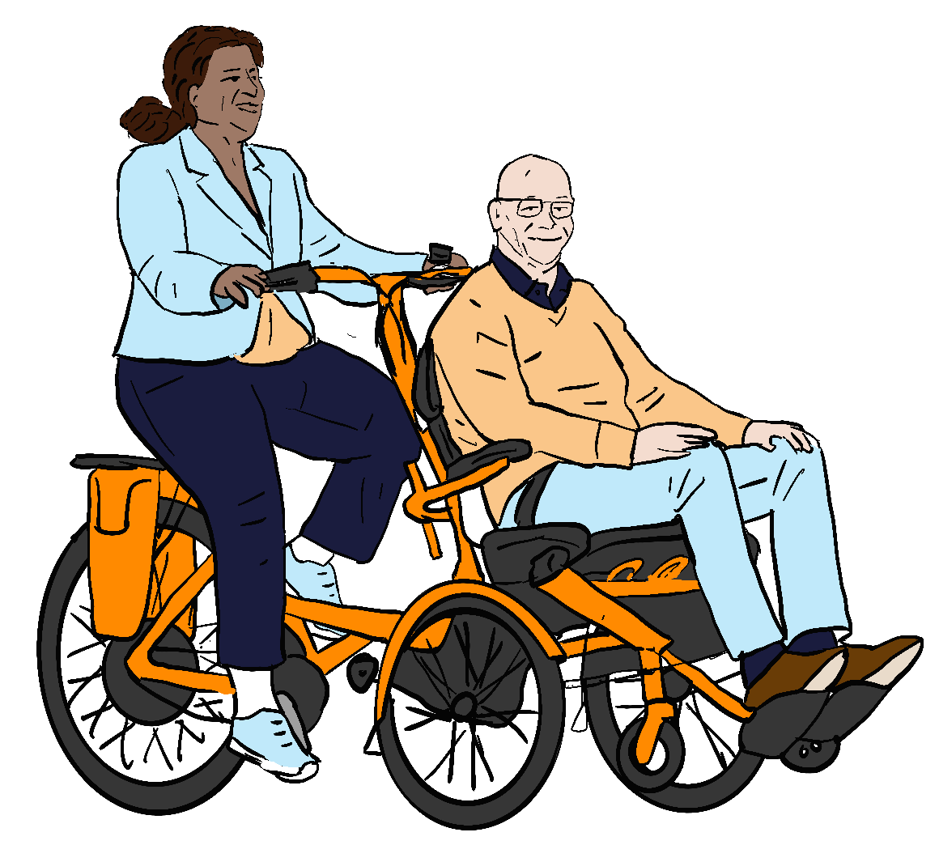
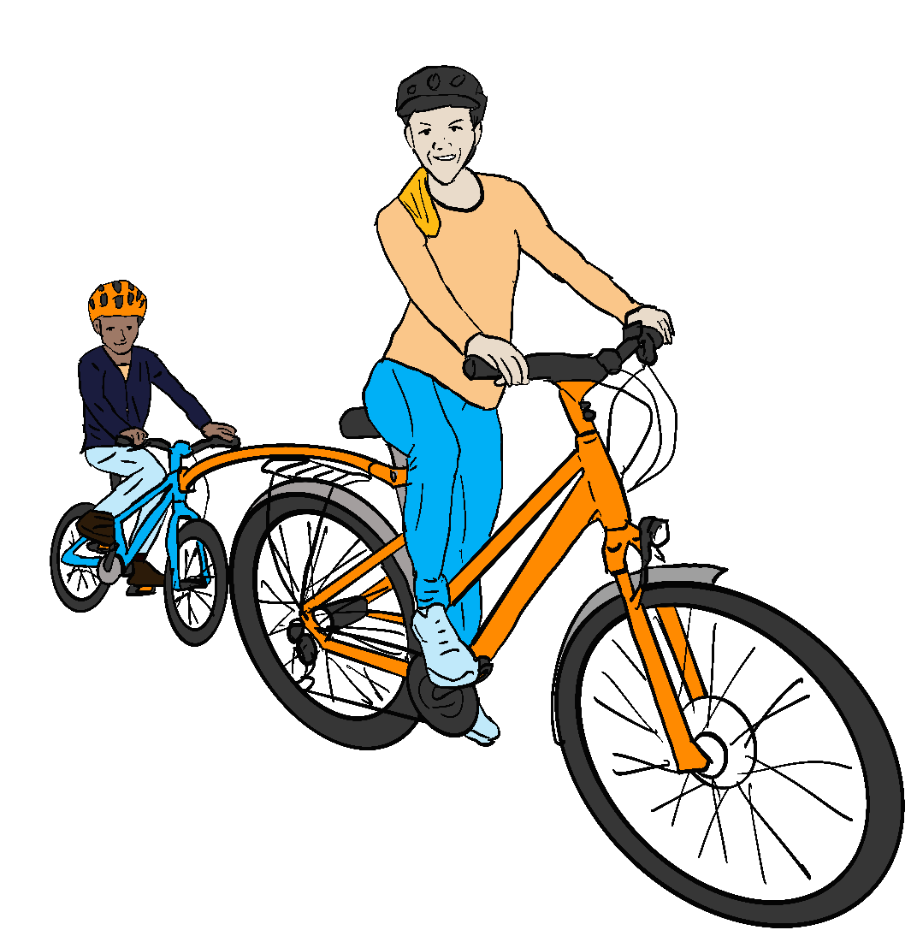
Mobility for all – product safety specifications
Keeping users and others safe:
Electrical safety – batteries, motors, chargers
Collision avoidance – braking, stability, hazard detection etc
Other user and public safety – multi-person devices/attachments, device “trains”, trailers and cargo capacity, control systems…
Detailed product-specific safety requirements should be in product safety standards, not public spaces device regulations.

Slide 26
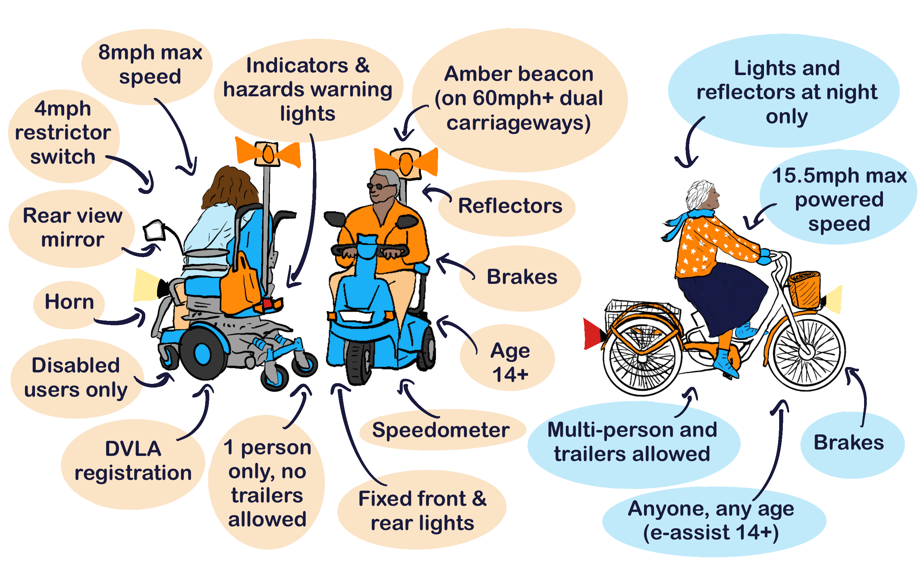
Consultation – class 3 “invalid carriage” requirements
It is not possible or practical for many aid types to meet class 3 requirements, including:
Aids which can freewheel - cycles and e-assist devices;
Many power attachment types.
Class 3 requirements are excessive, unreasonable and unsafe.
Other pedestrians, cycle and micromobility users do not have to meet equivalent requirements.
For use 4mph - 8mph on road only, devices must meet all class 3 criteria. Class 3 devices are not permitted to use cycle lanes or bus lanes and must stay at 4mph or less on bridleways, cycle tracks and restricted byways.

Slide 27
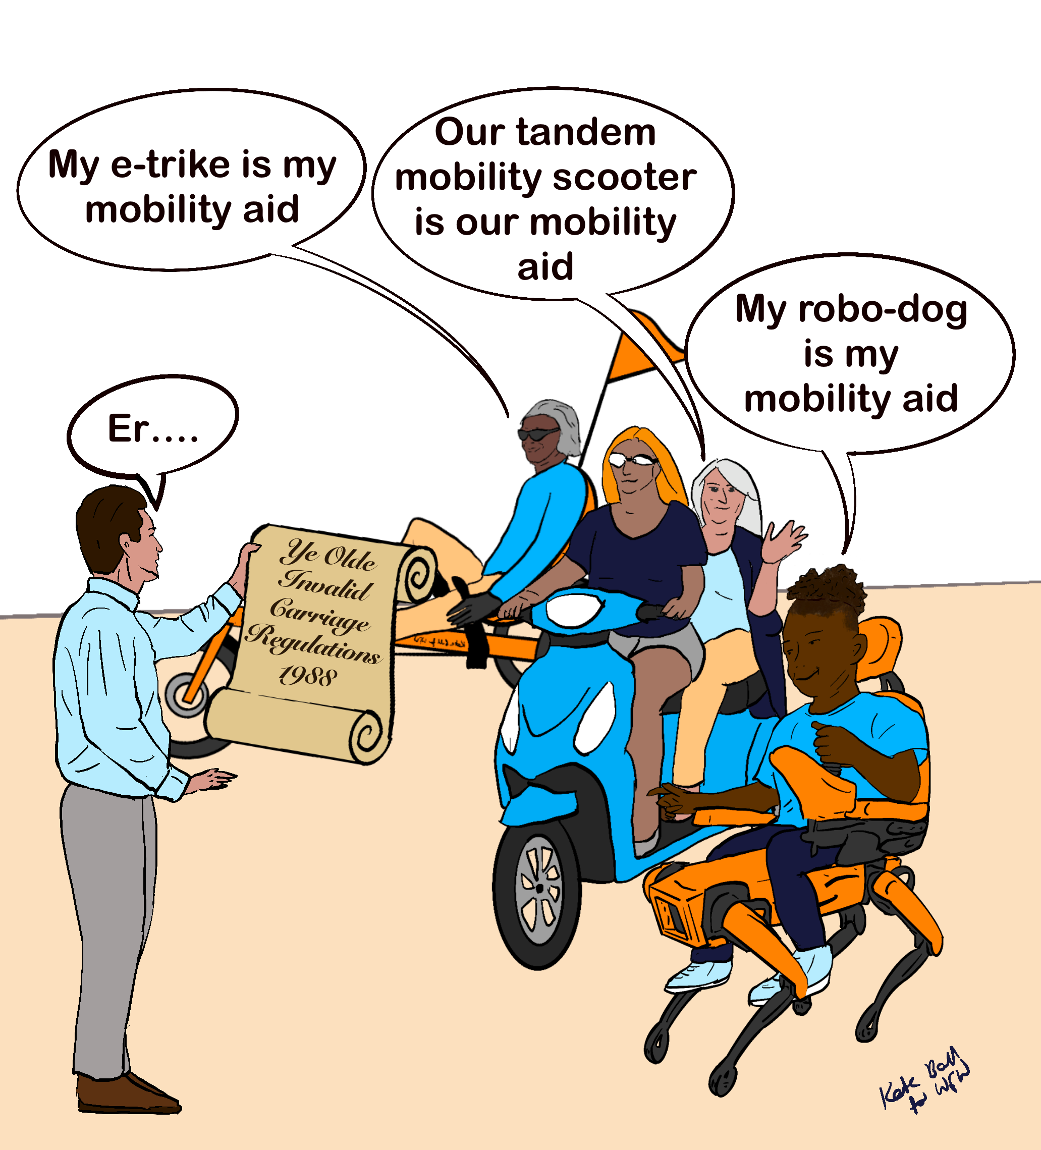
Consultation - achieving positive legal changes
Use the upcoming Low Speed Zero Emission Vehicle (LZEV framework) to legally recognise all pedestrian and cycling-equivalent devices as mobility aids when used by a Disabled person to assist with or replace pedestrian movement.
Implement equality of access rights for mobility aid users with non-disabled pedestrians in all pedestrian-access spaces, and with non-disabled cyclists in all cycle-permitted spaces.
Retain and improve “invalid carriages” regulations:
Ensuring VAT exemptions are retained for devices already regulated as in-class “invalid carriages”
Extending VAT exemptions to all MHRA certified class 1 medical device mobility aids when bought by or for use of a Disabled person or people.
We believe there are practical, workable, rapid ways to achieve inclusive, equitable, future-proofed, least-restrictive mobility aid regulations.

Slide 28
Consultation – questions and topics
Defining mobility devices – Q 1-6:
Consultation objectives “need” vs “quality of life”, “Invalid carriage” vs mobility device, Disabled-only restriction.
Age restrictions – Q 8-9, 18-19, 20-23, 24-27, 28-30:
Direct for users/passengers, indirect via “class 3”, micromobility, cycle and e-cycle regulations
Device specifications – Q 10-13, 14-17, 20-23, 24-27, 28-30:
Weight limits, “class 3” requirements, dimensions/manoeuvrability, access rights for different size devices e.g. into all buildings, public transport/services, outdoor spaces.
Safe use of spaces and permitted use locations – Q 1-2, 8-9, 14-17, 24-27, 28-30:
Rights of equal access to mobility (devices and locations), right to comparable speeds– pavements, cycle tracks/lanes, bus lanes, bridleways, restricted byways, roads. Presumption of competence for Disabled and non-disabled people.
Risks and benefits of changing mobility regulations – Q 1-2, 17, 19, 20-23, 24-27, 30:
Questions worded to focus on device-specific risks, not direct or wider benefits. Need to recognise individual, family, community and societal benefits of improved mobility for Disabled people.
Goal: Regulations allowing equal access to least-restrictive, future-proofed, safe pedestrian, cycling and cycling-equivalent mobility options for all Disabled people.

Slide 29
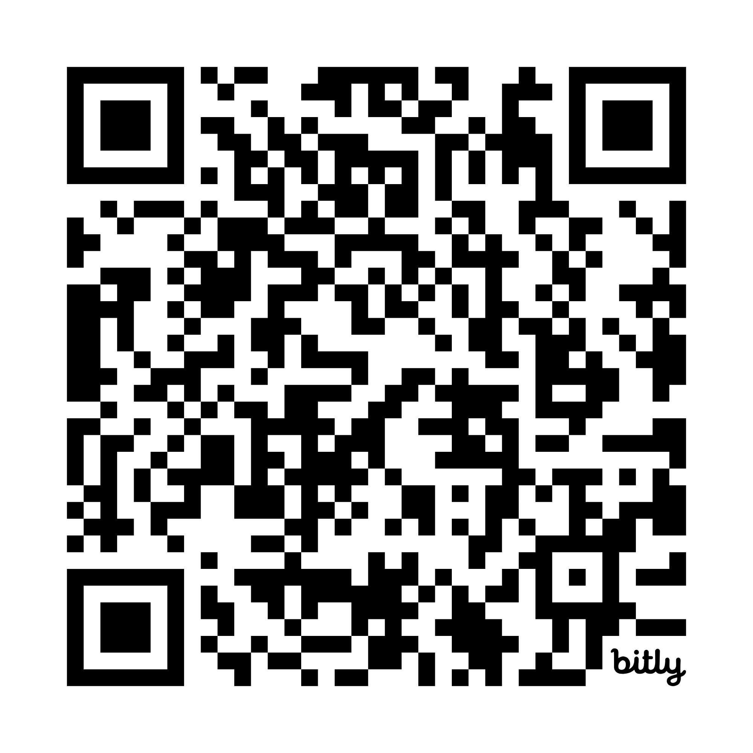





Thanks for listening
Find out more on our Every Journey, Everyone campaign page:
wheelsforwellbeing.org.uk/ejeo/
Contact us for more information:
info@wheelsforwellbeing.org.uk
@WheelsForWellbeing

